Slide 1
EE5907 Pattern Recognition EE5027 Statistical Pattern Recognition
BT Thomas Yeo
ECE, CSC, TMR, N.1, HMS

Slide 2
Topics
Thomas Yeo (EE5907 Part I + EE5027)
Contact: thomas.yeo@nus.edu.sg
Bayesian decision theory
Parameter estimation & supervised learning
Non-parametric techniques
Robby Tan, Mike Shou, Wang Xinchao (EE5907 Part II + EE5026)
Unsupervised / supervised dimensionality reduction
Clustering and Applications
Deep learning
Notes:
Hi, my name is Thomas Yeo.
I am the lecturer for EE5907. EE5907 is split into two halves. I will teach the first half. I will cover Bayesian decision theory, parameter estimation and supervised learning. I will also cover non-parametric techniques. This first half is equivalent to EE5027.
The second half of EE5907 will cover unsupervised and supervised dimensionality reduction, clustering, applications and a bit of deep learning. The second half is equivalent to EE5026.

Slide 3
(Rough) Schedule
Week 1 | Introduction + Probability Review
Week 2 | Parameter Estimation (ML, MAP, Bayesian) Generative & Discriminative models Conjugate Distributions
Week 3 | Univariate Gaussian + Parameter Estimation (ML, MAP, Bayesian) Naive Bayes
Week 4 | Supervised learning (logistic regression)
Week 5 | Non-parametric techniques (KNN, Parzen’s window)
Week 6 | Bayesian Statistics / Decision Theory

Slide 4
Hours
Lecture: 6pm – 9pm (Thurs) @ Zoom
Thomas’ office hours:
After lecture @ Zoom
For second half of semester, by appointment only

Slide 5


TA: EE5027 + first half of EE5907
Office hours: 6pm – 7pm (Monday) @ Zoom or by appointment
Zoom meeting ID: 851 7898 3125
Password: 001
Leon Ooi (e0471099@u.nus.edu)
Yan Xiaoxuan (e0012668@u.nus.edu)
For students appealing to join the class, please email Leon or Xiaoxuan your email ID (the one starting with “e”) and they will add you as guests on LumiNUS. Remember to cc me.

Slide 6
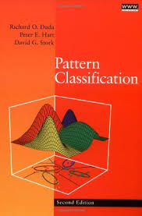

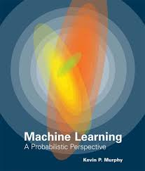
Textbook & References
Pattern Classification by Duda,
Hart and Stork, John Wiley, 2001.
Machine Learning: A Probabilistic Perspective, Kevin Murphy, 2012
Computer Vision: Models, learning and inference, Simon Prince, 2012
Free: www.computervisionmodels.com
Notes:
There are three optional textbooks for this class.
Pattern Classification by Duda and Hart
Machine Learning, a probabilistic perspective by Kevin Murphy.
Computer Vision: Models, Learning and Inference by Simon Prince. This book can be downloaded for free here.

Slide 7
Pre-requisites
Pre-requisites
Probability, statistics, and linear algebra (vector spaces and matrix theory) as taught in typical undergraduate courses
Probability and statistics are especially important for first half of EE5907 + EE5027
Programming in MATLAB/Python, or standard languages such as C, C++, Java, etc
You will find this class very difficult if you don’t have the pre-requisites
If this is your first graduate class, you will also find it to be substantially more difficult than your undergrad courses
Notes:
I am going to assume that you are familiar with probability, statistics, and linear algebra
You should also be familiar with matlab or be able to program in standard languages such as C, C++ etc.

Slide 8
State-of-the-Art
EE5907/EE5027/EE5026 do NOT cover state-of-the-art. Teach concepts needed to understand state-of-the-art
For state-of-the-art:
Conference papers: CVPR, ICCV, ECCV, ICML, ICLR, NeurIPS, etc
Journal articles: IJCV, T-IP, JMLR, T-PAMI, etc
EE6733: Advanced Topics on Vision and Machine Learning
EE5934/EE6934: Deep Learning
Notes:
Since we are using materials from textbooks, by definition, the stuff we will cover are NOT state of the art. However, we will teach you basic concepts necessary to understand the state-of-the-art
If you are interested in state-of-the-art machine learning, you can read conference papers from conferences such as CVPR, ICCV, ECCV, ICML, NeurIPS, etc. Or you can read journal papers from journals, such as IJCV, T-IP, JMLR, T-PAMI, etc.
Our department also offers a seminar class EE6733, where you will read papers from these top conferences and journals.
There is also a deep learning course EE5934/EE6934.

Slide 9
LuminNUS
Lecture slides
Condensed version in PDF format (you can search for terms in this format)
Long PPT version with detailed notes
Lecture video will be available on LuminNUS
Assignments & solutions
Assignment starts this very week!
Assignments not graded, but you should do them!
Will go through solutions of some problems in class
Solutions posted one week after assignment
Notes:
Each week, I will post lecture slides on LuminNUS, both a condensed version as well as version with detailed notes because in previous years, there are some students who have a hard time following in class.
Each week, I will also assign some problems for you to solve. The first assignment has already been posted. The assignments will not be graded, but I will go through some questions in the following week’s lecture. I will also post the solutions then.
Since the assignment will not be graded, you will probably be VERY tempted to simply read the solutions directly. However, I really encourage you to try out the problems before looking at the solutions. Because it will really help you understand the material better!

Slide 10
Assessments
EE5907
2 CAs (2 x 20%)
Individual projects (absolutely no copying permitted)
Final Exam (60%)
More information to come
EE5027
1 CA (40%) same as EE5907 CA1
Final exam (60%)
More information to come

Slide 11
CA1 (EE5907 + EE5027)
CA1 handed out on week 3
Due Monday after recess week
Worth 20% of your grades for EE5907 & 40% of your grades for EE5027
Four sections following lectures 3 to 5.
Lectures teach theoretical concepts
Ungraded homework helps you understand theoretical concepts
CA1 lets you implement these theoretical concepts
Please do NOT wait till last minute
According to students from previous years: average = 34 hours (min = 5 hours, max = 120 hours)

Slide 12
Questions?
Notes:
Any questions before I continue?

Slide 13
Introduction
Notes:
I will move on to introduction

Slide 14
What is Artificial Intelligence (AI)?
AI = intelligence displayed by machines
Unsolved since 1950s
Recent impressive results by universities (e.g., UoT, NYU, etc) and companies (e.g., Deepmind, Google)
Resurgence made possible by machine learning
Notes:
As you probably know, Artificial intelligence is intelligence displayed by machines, instead of humans. This is something that computer scientists have been trying to achieve since the 1950s.
These efforts have largely failed, but in the last few years, there is a resurgence of interest because of impressive results obtained by researchers from universities like the University of Toronto and companies like DeepMind.
This resurgence is made possible because of advances in machine learning.

Slide 15
What is Pattern Recognition / Machine Learning?
Will use both terms interchangeably
Pattern Recognition: automatically detect patterns from data
Machine Learning: Learn from data without being explicitly programmed
Notes:
In this class, I will use the phrase “pattern recognition” and “machine learning” interchangeably, although they have slightly different definitions.
The goal of pattern recognition is to automatically detect patterns from data
On the other hand, the goal of machine learning is to learn from data without being explicitly programmed.

Slide 16
What is Pattern Recognition / Machine Learning?
Will use both terms interchangeably
Pattern Recognition: automatically detect patterns from data
Machine Learning: Learn from data without being explicitly programmed
Applications
Email SPAM detection
Speech recognition (e.g., SIRI)
Handwritten digit recognition (e.g., sorting snail mail)
Notes:
There are many real life applications of machine learning.
According to Microsoft, 97% of emails are SPAM. Without automatically filtering out these SPAM emails, communication by email would be impossible!
In automatic speech recognition, we want to automatically convert audio speech into text. Many smartphones now have apps that can recognize voice commands.
Machine learning can be used to recognize handwritten digits. This allows post offices to automatically sort through millions of physical mail to automatically decide where the mail is going based on the zipcode.

Slide 17
What is Pattern Recognition / Machine Learning?
Will use both terms interchangeably
Pattern Recognition: automatically detect patterns from data
Machine Learning: Learn from data without being explicitly programmed
Applications
Email SPAM detection
Speech recognition (e.g., SIRI)
Handwritten digit recognition (e.g., sorting snail mail)
Google search
Driverless cars
Banking fraud detection
Notes:
Google search relies on machine learning.
Self-driving cars also rely on machine learning.
Machine learning is useful for detecting banking fraud.

Slide 18
What is Pattern Recognition / Machine Learning?
Will use both terms interchangeably
Pattern Recognition: automatically detect patterns from data
Machine Learning: Learn from data without being explicitly programmed
Applications
Email SPAM detection
Speech recognition (e.g., SIRI)
Handwritten digit recognition (e.g., sorting snail mail)
Google search
Driverless cars
Banking fraud detection
Detection and diagnosis of diseases
Biometric (e.g., fingerprint security)
DNA sequence identification (e.g., Counsyl)
Manufacturing (e.g., machine vision)
Notes:
In the near future, I expect machine learning will become prevalent for detecting and diagnosing diseases.
I can go on and on, but let me just show you this impressive demo from Google.

Slide 19

Google Assistant

Slide 20
Types of Machine Learning
Notes:
Any questions before I discuss various types of machine learning?
We can divide machine learning into a few kinds.

Slide 21
Supervised Learning
Given input-output pairs D = {x_{i}, y_{i}}_{i=1:N} , learn mapping y = f(x)
D = training set
Notes:
The first type of machine learning is called supervised learning.
We are given a training dataset D. D consists of N data points. Each datapoint consists of an input-output pair xi and yi. Xi is the input and yi is the output.
Our goal is to learn the mapping from the input x to the output y. In other words, we want to learn the function y = f of x.

Slide 22
Supervised Learning
Given input-output pairs D = {x_{i}, y_{i}}_{i=1:N} , learn mapping y = f(x)
D = training set
x (images, emails, molecular shapes, etc) typically represented as p-dimensional vector (called features)
Notes:
x can be images, emails, molecular shapes and so on.
We typically represent x as D-dimensional vectors, called features.

Slide 23
Supervised Learning
Given input-output pairs D = {x_{i}, y_{i}}_{i=1:N} , learn mapping y = f(x)
D = training set
x (images, emails, molecular shapes, etc) typically represented as p-dimensional vector (called features)
y also called output or target variable
y discrete => problem known as classification
y continuous => problem known as regression
Notes:
y is called the output or target variable.
If the y is discrete, then the supervised learning problem is called classification.
If the y is continuous, then this problem is called regression.

Slide 24
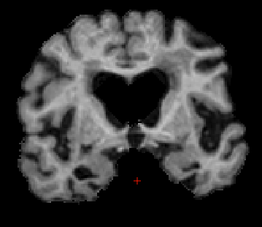
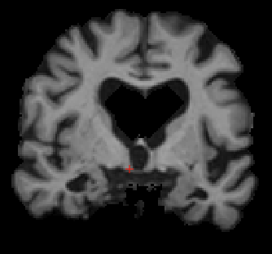
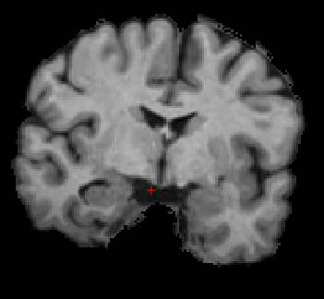
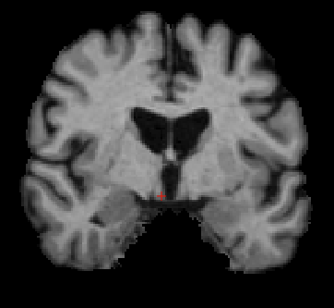
Supervised Learning
Given input-output pairs D = {x_{i}, y_{i}}_{i=1:N} , learn mapping y = f(x)
D = training set
x (images, emails, molecular shapes, etc) typically represented as p-dimensional vector (called features)
y also called output or target variable
y discrete => problem known as classification
y continuous => problem known as regression
Training: Learn relationship between inputs (MRI) & target labels (AD or healthy)
…
Alzheimer’s
Disease (AD)
…
Healthy
x = MRI images, y = AD or healthy
Notes:
For example, we might give the algorithm a database containing MRI images and each MRI image is labeled as coming from an Alzheimer’s patient or a healthy participant.
The supervised learning algorithm will learn the relationship between the MRI images and the target labels.

Slide 25
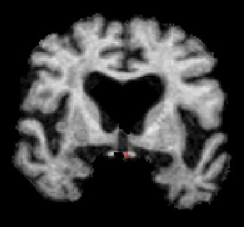
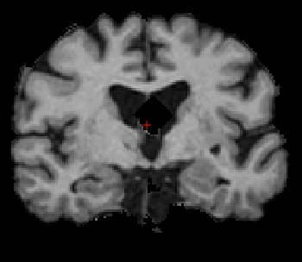
Supervised Learning
Given input-output pairs D = {x_{i}, y_{i}}_{i=1:N} , learn mapping y = f(x)
D = training set
x (images, emails, molecular shapes, etc) typically represented as p-dimensional vector (called features)
y also called output or target variable
y discrete => problem known as classification
y continuous => problem known as regression
Training: Learn relationship between inputs (MRI) & target labels (AD or healthy)
Testing: Given new MRI,
Predict AD or healthy
…
Alzheimer’s
Disease (AD)
Healthy or AD?
…
Healthy or AD?
Healthy
x = MRI images, y = AD or healthy
Notes:
And then given a new test image, the algorithm will try to predict whether the patient is healthy or has Alzheimer’s disease.

Slide 26
Unsupervised Learning
Notes:
In unsupervised learning, our dataset D only consists of x, but no y.
Again x can be images, emails, molecular shapes, etc. And x are still represented as p-dimensional vectors.
The goal here is learn “interesting” structure in the data.

Slide 27
Unsupervised Learning
Notes:
Unsupervised learning is attractive because labeling the data can be very expensive.
For example, in supervised object detection, we will need many training images where different objects are labeled, such as chairs, tables, cars, humans etc. This is of course very labor intensive and expensive. Therefore it will be nice if we can present images to the computer and the computer automatically discovers object categories.
In other situations, we really do NOT know what categories or patterns are in data, so we really want to automatically discover these patterns or trends.

Slide 28
Unsupervised Learning
Notes:
However because there are no target class labels Ys that we want to learn, this means that the problem is open-ended and there is no groundtruth. This makes validation and comparison between algorithms to be quite hard.

Slide 29
Unsupervised Learning
Input
…
…
x = MRI images
Notes:
Let’s consider the previous example again. Now, we are just given the MRI images. And we are supposed to discover something interesting about the data.

Slide 30
Unsupervised Learning
Input
…
Output
…
…
…
x = MRI images
Notes:
So in this example, maybe our unsupervised algorithm might learn to divide MRI images into 2 categories and we may confirm posthoc that these categories correspond to Alzheimer’s patients and healthy controls.
But there is no guarantee this will happen! Maybe our algorithm will instead divide the MRI images into male versus female subjects, or old versus young people.
In some sense, there may NOT be a single right answer!

Slide 31
Types of Machine Learning
Summary
Supervised learning: Great if we know what we want to predict
Unsupervised learning: Great if we want to discover something new
Notes:
To summarize, supervised learning is great if we know what we want to predict.
But if we want to discover something new from our data, we should use unsupervised learning.

Slide 32
Types of Machine Learning
Summary
Supervised learning: Great if we know what we want to predict
Unsupervised learning: Great if we want to discover something new
Other learning not covered in this class
Semi-supervised: some data has target labels, some don’t
Notes:
This class will be mostly concerned with supervised and unsupervised machine learning. There are at least two other types of learning that we will not cover.
In semi-supervised learning, some of the data have labels y, some data don’t. So it’s a hybrid between supervised and unsupervised learning.

Slide 33
Types of Machine Learning
Summary
Supervised learning: Great if we know what we want to predict
Unsupervised learning: Great if we want to discover something new
Other learning not covered in this class
Semi-supervised: some data has target labels, some don’t
Reinforcement learning: learn actions by trial & error
Agent
Action
Observation
+ Delayed Reward
Environment
Notes:
In reinforcement learning, there is an agent interacting with the environment. The agent attempts to learn by trial and error.
Basically the agent will perform some action and in turn receives reward, which might not occur immediately. This is what makes reinforcement learning difficult. So the agent might be performing actions for some time but might not be sure if they are doing the right thing.
For example, imagine there is an animal foraging for food. The food is the reward, but the reward might come sporadically.

Slide 34
Questions?
Notes:
Any questions before I continue?

Slide 35
Some Background Knowledge in Machine Learning
Notes:
Let’s start off with some background knowledge in machine learning.

Slide 36
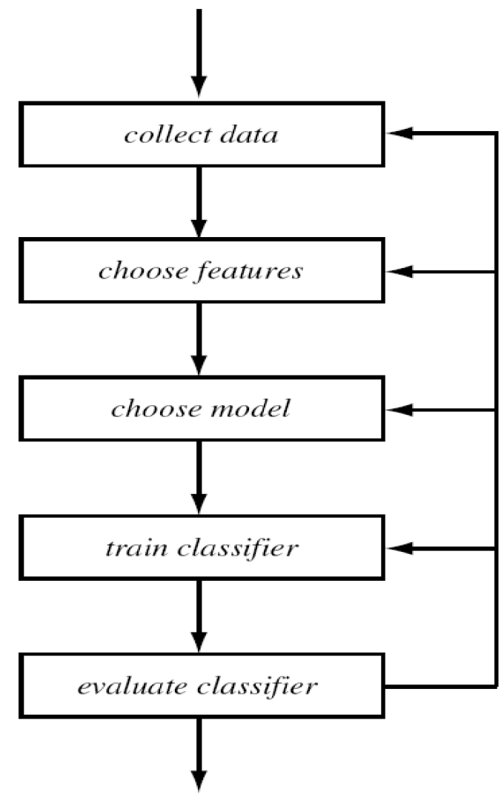
Design Cycle For Supervised Learning
Notes:
Designing a machine learning system usually involve the following steps.
We first have to collect the data, then we choose the features and the classifier, and then we train the classifier on the training data and then validate the resulting classifier on the test set.

Slide 37
Design Cycle For Supervised Learning
Notes:
But for anyone in this class who already has some experience in machine learning, we know that in practice, nothing is going to work the first time round.
Therefore a lot of time, we have to go back and redo some of the steps!
This may require us to change the features we use or change how we train the classifier. In the worst case scenario, we even have to recollect our data!

Slide 38
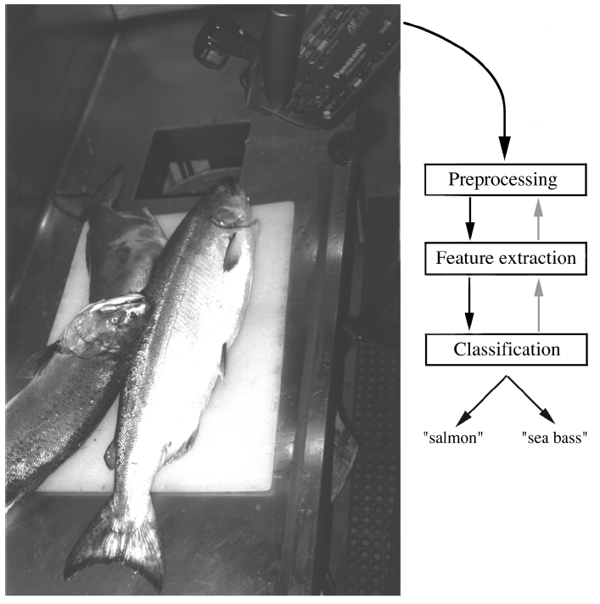
Design Cycle Example: Salmon vs Seabass
Notes:
Let’s discuss a toy example on supervised learning that illustrates this design cycle.
Suppose a fish packing factory wants to automate the process of sorting fishes on a conveyer belt.
Maybe we want to divide incoming fishes into salmon and sea bass

Slide 39
Design Cycle Example: Salmon vs Seabass
Data collection
Set up convey belt and cameras, capture images
Notes:
We have to start by setting up the conveyer belt and cameras, capture the images and label the images as containing salmon OR sea bass.

Slide 40
Design Cycle Example: Salmon vs Seabass
Data collection
Set up convey belt and cameras, capture images
Preprocessing
Image enhancement, remove background, separate occluding fishes, extract single fish (segmentation)
Notes:
We have to preprocess the images. Maybe we need to enhance the image, remove background, separate the occluding fishes, extract a single fish and so on.

Slide 41
Design Cycle Example: Salmon vs Seabass
Data collection
Set up convey belt and cameras, capture images
Preprocessing
Image enhancement, remove background, separate occluding fishes, extract single fish (segmentation)
Divide data into training and test sets
Feature extraction/engineering, e.g., measure certain features of fish to be used for classifier
Train classifier on training set and evaluate on test set
Notes:
We can then divide our single fishes into training and test sets.
We can then extract some features to be used in the classifier. Possible features might include the length of the fish, or the width of the fish or the brightness of the fish and so on.
Once we settle on the features, we can then choose a classifier and train the classifier using the training data and validate on a test set of new fishes.

Slide 42
Design Cycle Example: Salmon vs Seabass
Data collection
Set up convey belt and cameras, capture images
Preprocessing
Image enhancement, remove background, separate occluding fishes, extract single fish (segmentation)
Divide data into training and test sets
Feature extraction/engineering, e.g., measure certain features of fish to be used for classifier
Train classifier on training set and evaluate on test set
Re-visit previous steps if performance unsatisfactory
Notes:
If the results are unsatisfactory, we have to revisit the previous steps.

Slide 43
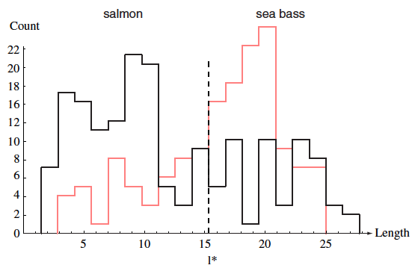
Feature Engineering is Important!
l* minimizes number of errors
Notes:
For example, maybe we start by testing if the length of the fish is good for differentiating between salmon and sea bass.
Here I am showing histograms of fish length. The salmon histogram is shown in black. the sea bass histogram is shown in pick.
For a decision threshold l, if a fish has length below l, we classify the fish to be salmon. If the fish has length above l, we classify the fish to be sea bass
l* is the optimum decision threshold that minimizes the number of errors.
We see that even with the optimum decision threshold l*, there is still a lot of errors because the two histograms overlap a lot.

Slide 44
Feature Engineering is Important!
l* minimizes number of errors
Dotted line called decision boundary:
Fish left of decision boundary classified as salmon.
Fish right of decision boundary classified as sea bass
Notes:
This dotted line is called the “decision boundary”.
Fish on the left of the decision boundary is classified as Salmon.
Fish on the right is classified as sea bass.

Slide 45
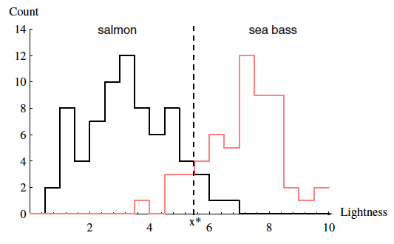
Feature Engineering is Important!
x* minimizes number of errors
Notes:
So maybe instead of fish length, we can look at the lightness of fish.
In this case, the two histograms do not overlap that much, so the optimum decision boundary x* achieve a pretty low number of errors.

Slide 46
Decision Theory: Not All Errors are Equal
Notes:
However, in real applications, it is very important to recognize that not all errors are the same.
Maybe customers are ok with getting salmon when buying sea bass.
But they will be very upset if they get sea bass when buying salmon.

Slide 47
Decision Theory: Not All Errors are Equal
Notes:
To minimize angry customers, we might shift the decision boundary x* to the left. By doing so, we reduce the number of seabass that are falsely classified as salmon. So all these (pink) sea bass which were originally classified as salmon will now be correctly classified as sea bass.
However, all these (black) salmon will now be wrongly classified as sea bass, which is ok since customers do not mind getting salmon when they are buying seabass.

Slide 48
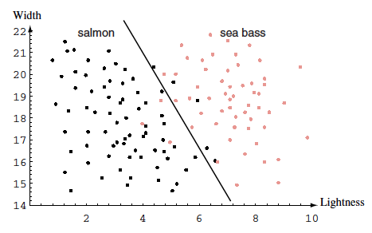
Curse of Dimensionality
Decision boundary
Notes:
In addition to lightness, we can try to add more features. Maybe we can consider adding width as a feature.
This black line is the new decision boundary. Fishes that fall on the left of the boundary are classified as salmon. Fishes that fall on the right of the boundary are classified as sea bass.
By adding “width” as a feature, the resulting error rate is lower than by using only one feature.

Slide 49
Curse of Dimensionality
Decision boundary
Notes:
But we have to be careful of course. More features can improve performance, but some features might be useless.
So if we have a lot of useless features, this can confuse classifier and we can get worse results!
This is called curse of dimensionality, where too many dimensions can lead to poor performance.

Slide 50
Curse of Dimensionality
For fixed amount of data samples N (e.g., number of fish photos), as we increase number of features
Training error might keep decreasing
Test error might decrease and then increase
Error
Error in test set
Error in training set
Number of features / dimensions
Notes:
So generally speaking, if we have a fixed number of data samples N. In our example, this would be the number of fish.
As we increase the number of features, the training error (blue curve) will keep dropping.
However, that might not be the case for the test error (red curve). As we increase the number of features, the test error (red curve) might drop at the beginning, but the error will eventually get worse.

Slide 51
Curse of Dimensionality
For fixed amount of data samples N (e.g., number of fish photos), as we increase number of features
Training error might keep decreasing
Test error might decrease and then increase
Error
Error in test set
Gap between training & test errors is called overfitting
Error in training set
Number of features / dimensions
Notes:
This gap between training and test errors is called overfitting.

Slide 52
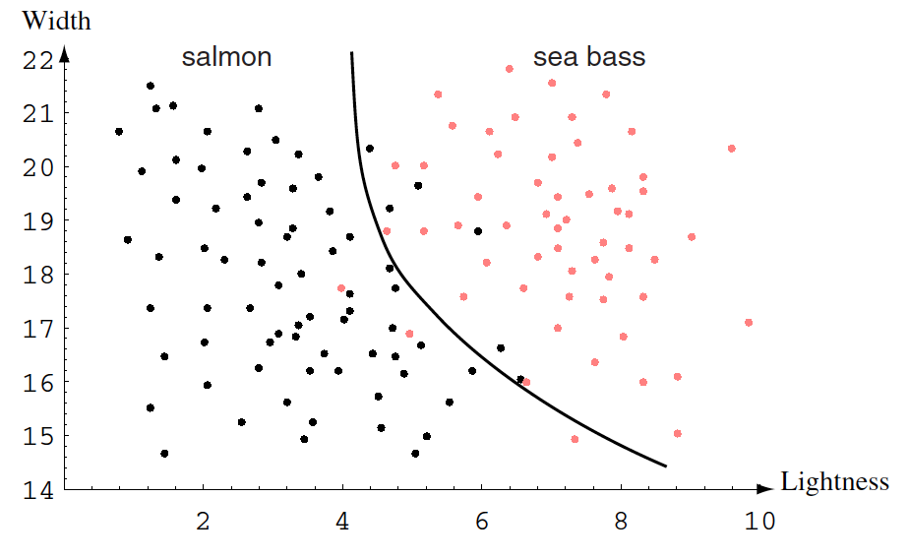
Model Complexity
Instead of increasing the number of features, can also use more complex decision boundaries (models)
This can potentially reduce errors, but might also increase errors
Shifting from linear straight line to quadratic curve reduces errors (in this example)
Notes:
Instead of increasing the number of features, we can also use more complex decision boundary. Previously our decision boundary is a linear straight line, but we can for example have a quadratic decision boundary. In this example, we actually improve our classification errors.

Slide 53
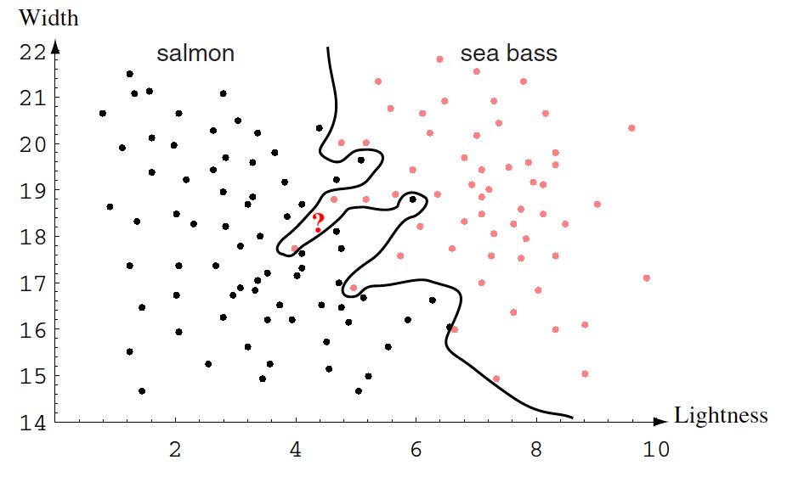
Model Complexity
Instead of increasing the number of features, can also use more complex decision boundaries (models)
This can potentially reduce errors, but might also increase errors
Shifting from linear straight line to quadratic curve reduces errors (in this example)
“?” likely to be salmon, but
classified as sea bass
Notes:
However, if the decision boundary is too complex, we might get good performance in our training set, but our classifier might not generalize well to new data.
For example, with the very complicated decision boundary on the right, the black dots are on one side of the decision boundary and the pink dots are on the other side. So we get 100% accuracy in our training data.
However, imagine that we observe a new fish at the question mark. Looking at the pattern of pink and black dots, this new fish is probably a salmon, but according to the complex decision boundary, this new fish will be classified as sea bass.

Slide 54
Model Complexity
Instead of increasing the number of features, can also use more complex decision boundaries (models)
This can potentially reduce errors, but might also increase errors
Model complexity roughly related to # model parameters (e.g., quadratic decision boundary requires more parameters to specify than linear decision boundary)
Shifting from linear straight line to quadratic curve reduces errors (in this example)
“?” likely to be salmon, but
classified as sea bass
Notes:
What does it mean for a model to be complex?
Roughly speaking a model is more complex if it has more parameters.
So if the decision boundary is a straight line, then in 2-dimensional data like here, you only need two parameters to specify the linear decision boundary.
But a quadratic decision boundary will require more parameters to specify, so a quadratic decision boundary is a more complex model.

Slide 55
Model Complexity
For fixed amount of data samples N (e.g., number of fish photos), as we increase number of model parameters
Training error might keep decreasing
Test error might decrease and then increase
Error
Error in test set
Gap between training & test errors is called overfitting
Error in training set
Model Complexity (# model parameters)
Notes:
Like before, suppose we have a fixed number of data samples N. In our example, this would be the number of fish.
As we increase the model complexity, the error might at first drop. But if we keep increasing model complexity, the error might get worse.

Slide 56
Training, Validation, Test Sets
To really test the quality of our algorithm, need to evaluate generalization error on test set
However, splitting data into training-test set not enough
Imagine we train an algorithm on training set and error is terrible in test set
We then train new algorithm on training set and error is now better in test set
But we will have used the test set twice. If you repeat this many times, you will overfit to the test set
Best practice: split data into training, validation and test sets
Train on training set & evaluate error on validation set
Repeat as many times as we like
Once satisfied with results, then apply to test set to get realistic error quantification
Notes:
From the previous slides, it should be clear that to really test the quality of the algorithm, we need to evaluate the accuracy on a test set.
However, splitting data into training-test set is not enough.
Imagine you train an algorithm on the training set and the error was terrible in the test set
You then train new algorithm on training set and error is now slightly better in test set
And then you train a 3rd algorithm and apply to the test set. Eventually you will get very good test set errors.
But you will have used the test set many times, so you might have overfitted to the test set.

Slide 57
Training, Validation, Test Sets
To really test the quality of our algorithm, need to evaluate generalization error on test set
However, splitting data into training-test set not enough
Imagine we train an algorithm on training set and error is terrible in test set
We then train new algorithm on training set and error is now better in test set
But we will have used the test set twice. If you repeat this many times, you will overfit to the test set
Best practice: split data into training, validation and test sets
Train on training set & evaluate error on validation set
Repeat as many times as we like
Once satisfied with results, then apply to test set to get realistic error quantification

Slide 58
K-fold Cross-Validation
Sometimes not enough data => K-fold cross validation
Divide data into K sets (called folds)
Repeat for i = 1 to K
Take the i-th fold and call it the test fold
Train on remaining folds and test on i-th test fold
Notes:
However, sometimes there is not enough data, so some people use K-fold cross validation.
In k-fold cross validation, we divide our data into k sets, which are called “folds”.
We then train on all the data except the i-th fold and then we test our model on the i-th fold. We then repeat for i = 1 to K.

Slide 59
K-fold Cross-Validation
Sometimes not enough data => K-fold cross validation
Divide data into K sets (called folds)
Repeat for i = 1 to K
Take the i-th fold and call it the test fold
Train on remaining folds and test on i-th test fold
If K is equal to N (# data points) => leave-one-out cross-validation
Notes:
If K is equal to the number of data points N in our training set, then this is called leave-one-out cross validation.

Slide 60
K-fold Cross-Validation
Sometimes not enough data => K-fold cross validation
Divide data into K sets (called folds)
Repeat for i = 1 to K
Take the i-th fold and call it the test fold
Train on remaining folds and test on i-th test fold
If K is equal to N (# data points) => leave-one-out cross-validation
Same problem as before
If one algorithm gives poor K-fold cross-validation errors, and we repeat with a different algorithm, we will eventually overfit
Solution: Inner-loop (Nested) Cross-Validation
Repeat for i = 1 to K
Take the i-th fold and call it the test fold
Performing K’-fold cross-validation on remaining folds with different algorithms
Apply best algorithm to i-th test fold
Notes:
However, we have the same problem as before.
If one algorithm gives bad k-fold cross vaidation error and then we repeat with a different algorithm, eventually we will get good cross-validation error, but we are probably overfitting to our data.
The solution is inner-loop cross-validation or nested cross-validation.
Once again, we take the i-th fold and we call it the test fold. We perform K’-fold cross-validation on the remaining folds. And we can try different algorithm until our K’-fold cross-validation is good.
We can then apply the best algorithm from the training folds to the i-th test fold.

Slide 61
K-fold Cross-Validation
Sometimes not enough data => K-fold cross validation
Divide data into K sets (called folds)
Repeat for i = 1 to K
Take the i-th fold and call it the test fold
Train on remaining folds and test on i-th test fold
If K is equal to N (# data points) => leave-one-out cross-validation
Same problem as before
If one algorithm gives poor K-fold cross-validation errors, and we repeat with a different algorithm, we will eventually overfit
Solution: Inner-loop (Nested) Cross-Validation
Repeat for i = 1 to K
Take the i-th fold and call it the test fold
Performing K’-fold cross-validation on remaining folds with different algorithms
Apply best algorithm to i-th test fold
K-fold cross-validation more data efficient than training-validation-test, but more complicated and less “clean”

Slide 62





Computational Complexity is Important
people
?
✔
?
✔
✔
✔
✗
?
movies
✗
✔
✔
✗
✗
?
?
?
Notes:
One important consideration in machine learning is computational complexity.
To give you a real example, netflix is a multibillion dollar company in the U.S.. For about $10 a month, subscribers to netflix get to watch an unlimited number of movies and tv shows online.
Between 2006 and 2009, Netflix held a million dollar contest. And the goal of the contest is to come up with the most accurate algorithm to predict what movies people would enjoy watching.
For example, given that bart simpson enjoyed the batman movie, but hate aliens and spiderman, can we predict whether bart simpson like the lord of the rings movie? So the algorithm has to predict the question marks in this table given the likes and dislikes in the table.
What is relevant here is that Netflix ended up not implementing the winning algorithm because it was too complicated, and netflix felt it was not worth the engineering efforts. Instead Netflix ended up using a less complicated algorithm.

Slide 63
No Free Lunch Theorem
Notes:
Finally, it is important to remember that all models are wrong but some models are useful.
There is a famous theorem called the No free lunch theorem that essentially says that there is no universally best model that works well for ALL problems.
This is why there are so many different machine learning algorithms out there, because the algorithms make different assumptions and cover different kind of data and problems.

Slide 64
What will be covered?
Notes:
In this class, we assume that data is already collected and features are already chosen.
Instead we will focus on different models for classification, regression or unsupervised learning.
At least in the first part of this class, there will also be a strong bias towards probabilistic approaches.

Slide 65
Why Not Just Teach Deep Learning?
In certain settings, deep learning do not beat classical machine learning, e.g., logistic regression
These classical approaches can be significantly faster and easier to implement
Deep learning
Logistic Regression
Google Research, Scalable and accurate deep learning with electronic health records, NPJ Digital Medicine, 2018
Notes:
So why don’t we just teach deep learning?
In certain settings, deep learning do not beat classical machine learning
For example in this paper publish in Nature Digital Medicine by Google, even though deep learning is numerically better than logistic regression. 0.95 versus 0.93. However, if you look at the confidence intervals in brackets, the two algorithms are statistically indistinguishable.

Slide 66
Why Not Just Teach Deep Learning?
In certain settings, deep learning do not beat classical machine learning, e.g., logistic regression
These classical approaches can be significantly faster and easier to implement
Machine learning is cyclical
Our goal not to teach you only the popular stuff, but foundational knowledge useful regardless of what is popular because that will change
Deep learning
Logistic Regression
Google Research, Scalable and accurate deep learning with electronic health records, NPJ Digital Medicine, 2018
Notes:
Furthermore, machine learning is cyclical. Neural networks were hot in the 1980s, and then they became unpopular for 20 years before becoming popular again.
Our goal is not to only teach you the popular stuff. Our goal is to teach you foundational concepts that will be useful no matter what is popular.

Slide 67
Interim Summary
Different types of learning: supervised (classification vs regression), unsupervised, semi-supervised, reinforcement learning
Notes:
To summarize, we have discussed different kinds of machine learning: supervised, unsupervised, semi-supervised and reinforcement learning. We will focus on supervised and unsupervised learning in this class.

Slide 68
Interim Summary
Different types of learning: supervised (classification vs regression), unsupervised, semi-supervised, reinforcement learning
Iterative nature: collect data, choose features, choose models, train, test, rinse and repeat
Notes:
Deploying a real machine learning system is an iterative process. We have to collect data, select features, choose a model, train the model and then test the model.
And most likely, we have to repeat this multiple times to improve the performance of our system.

Slide 69
Interim Summary
Different types of learning: supervised (classification vs regression), unsupervised, semi-supervised, reinforcement learning
Iterative nature: collect data, choose features, choose models, train, test, rinse and repeat
Feature engineering (i.e., representation) is important
Notes:
Feature engineering is very important and good feature engineering is like an art form. A lot of time, if we choose the right features, even a very simple classification model can work very well.
Nowadays, there are algorithms such as deep learning that tries to learn the right features. But I assure you there is a lot of tweaking you need to do to in order for the neural network to work.
This class will not focus on feature engineering.

Slide 70
Interim Summary
Different types of learning: supervised (classification vs regression), unsupervised, semi-supervised, reinforcement learning
Iterative nature: collect data, choose features, choose models, train, test, rinse and repeat
Feature engineering (i.e., representation) is important
Decision theory: not all errors are equal
Notes:
It is important to note that not all errors are the same. So depending on the kind of errors that are important, we need to modify our model accordingly.

Slide 71
Interim Summary
Different types of learning: supervised (classification vs regression), unsupervised, semi-supervised, reinforcement learning
Iterative nature: collect data, choose features, choose models, train, test, rinse and repeat
Feature engineering (i.e., representation) is important
Decision theory: not all errors are equal
Curse of dimensionality, model complexity, overfitting
Notes:
We have discussed the curse of dimensionality and model complexity
Increasing the number of features and model parameters will improve training error.
Test error might also improve but eventually, when there are too many features or model parameters, we can obtain poor test error.
It is therefore important to select the model of the “right” complexity.

Slide 72
Interim Summary
Different types of learning: supervised (classification vs regression), unsupervised, semi-supervised, reinforcement learning
Iterative nature: collect data, choose features, choose models, train, test, rinse and repeat
Feature engineering (i.e., representation) is important
Decision theory: not all errors are equal
Curse of dimensionality, model complexity, overfitting
Training-validation-testing
K-fold cross validation
Notes:
This is often achieved by splitting your data into training, validation and test set. We train our model on the training set and evaluate on the validation set. When we are happy with our result, we then evaluate the accuracy on the test set. Remember the test set should only be used once at the very end.
Instead of training and test sets, we can also do k-fold cross-validation.

Slide 73
Interim Summary
Different types of learning: supervised (classification vs regression), unsupervised, semi-supervised, reinforcement learning
Iterative nature: collect data, choose features, choose models, train, test, rinse and repeat
Feature engineering (i.e., representation) is important
Decision theory: not all errors are equal
Curse of dimensionality, model complexity, overfitting
Training-validation-testing
K-fold cross validation
Computational Complexity
Notes:
Computational complexity is very important. Because a complex model can take too much computational time or memory requirements, and may therefore not be practical for certain applications.

Slide 74
Interim Summary
Different types of learning: supervised (classification vs regression), unsupervised, semi-supervised, reinforcement learning
Iterative nature: collect data, choose features, choose models, train, test, rinse and repeat
Feature engineering (i.e., representation) is important
Decision theory: not all errors are equal
Curse of dimensionality, model complexity, overfitting
Training-validation-testing
K-fold cross validation
Computational Complexity
No free lunch
Notes:
Finally, it is important to note that there is no one universal algorithm that performs the best for all problems.
Therefore, in this class, we will explore different models which make different assumptions. Different models will be suited for different problems.

Slide 75
Optional Reading I
These lecture notes based mostly D&H Chapter 1
KM Chapter 1 provides different introduction
More real world examples
Beware of typos
Notes:
Here are some some optional reading.
D&H stands for the book by Duda and Hart: Pattern recognition
KM stands for the book by Kevin Murphy: Machine Learning a probabilistic perspective.

Slide 76
Questions?
Notes:
Any questions before I continue?

Slide 77
Probability Review
Notes:
In the second half of this class, I will give a review of probability. Most of these concepts should NOT be new to you. If everything is new to you, then you will have trouble with this class.

Slide 78
What is a random variable?
A random variable x is a quantity that is uncertain
May be result of experiment (e.g., flipping a coin) or real world measurement (e.g., measuring temperature)
If observe x multiple times, we get different values
Some values occur more than others; this information captured by probability distribution p(x)
If x is discrete, then “p” is “probability mass function” (or pmf). If x is continuous, then “p” is “probability distribution function” (or pdf).
Adapted from S. Prince
Notes:
A random variable X is a quantity that is uncertain.
X may be the result of a random experiment, like flipping a coin. Or X may be the result of a real world measurement, like measuring the temperature in this room.
Since X is uncertain, this means that if we observe X many times, we will get different values.
Some values occur more frequently than others. This variation in frequency is captured by the probability distribution of the random variable X.
If x is discrete, then “p” is the “probability mass function” (or pmf). If x is continuous, then “p” is the “probability distribution function” (or pdf).

Slide 79
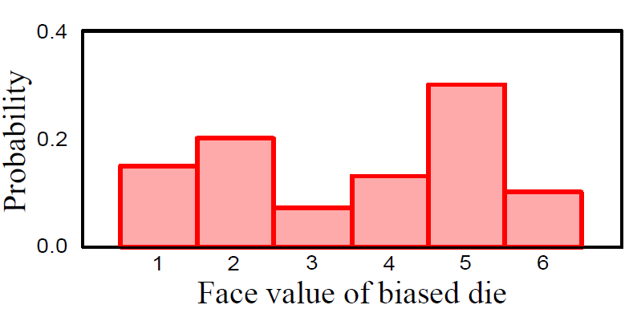
Discrete Random Variable x
Take on discrete values
Adapted from S. Prince
Notes:
A discrete random variable takes on a discrete set of values. For example, if we roll a biased dice represented here, 5 is the mostly likely value and 3 is the least likely value.
Now, by discrete, we don’t mean that the random variables can only take on integer values, what we mean is that

Slide 80
Discrete Random Variable x
Take on finite or countably infinite values
1.5
2.3
3.3
3.8
5
7
Adapted from S. Prince
Notes:
The random variable can take on a finite or countably infinite number of values. So here, the mostly likely value for our biased dice is still 5, but the least likely value is now 3.3.

Slide 81
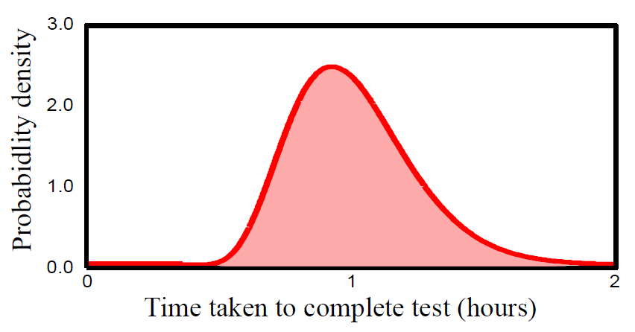
Continuous Random Variable
Notes:
On the other hand, a continuous variable is one that takes on a continuum or uncountably infinite number of values.

Slide 82
Famous Discrete Random Variables
Bernoulli: http://en.wikipedia.org/wiki/Bernoulli_distribution
Categorical: http://en.wikipedia.org/wiki/Categorical_distribution
Binomial: http://en.wikipedia.org/wiki/Binomial_distribution
Geometric: http://en.wikipedia.org/wiki/Geometric_distribution
Poisson: http://en.wikipedia.org/wiki/Poisson_distribution
…
Notes:
Here’s some famous discrete random variables. There’s Bernoulli, Categorical, Binomial, Geometric, Poisson, etc. Wikipedia has more information about each type of random variable.
You should have seen these distributions in your undergraduate probability class, except maybe categorical distribution.

Slide 83
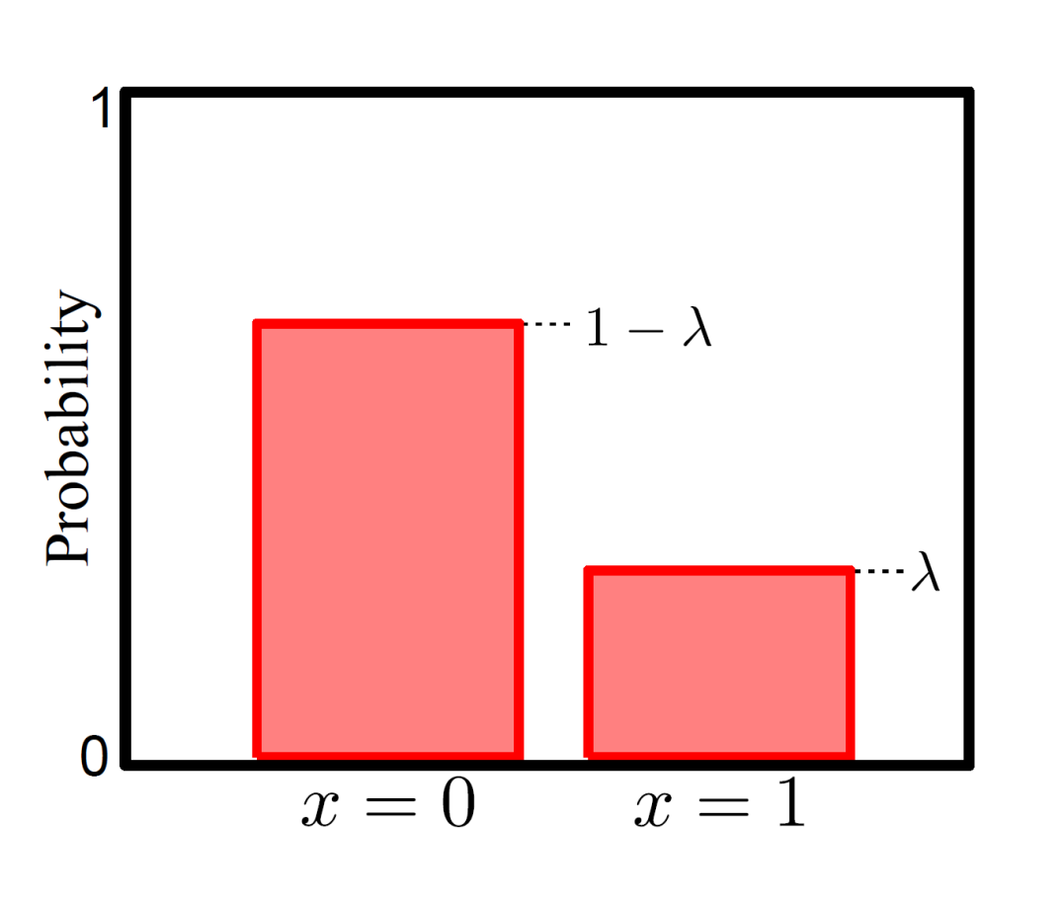
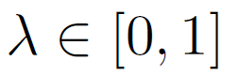
Bernoulli Distribution
Bernoulli distribution describes situation where only two possible outcomes x = 0 / x = 1 (e.g. failure/success)
Takes a single parameter
Notes:
To understand categorical distribution, let us remind ourselves about the Bernoulli distribution.
The Bernoulli distribution describes situations where only two outcomes are possible. The Bernoulli random variable X takes on values 0 or 1. 0 might represent failure, 1 might represent success. Or maybe we are tossing a coin. X = 1 indicates head and X = 0 indicates tail.
The Bernoulli distribution is controlled by a single parameter lambda, which is a number between 0 and 1,

Slide 84
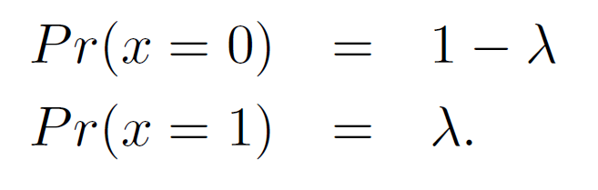
Bernoulli Distribution
Bernoulli distribution describes situation where only two possible outcomes x = 0 / x = 1 (e.g. failure/success)
Takes a single parameter
Notes:
X is equal to 1 with probability lambda and X is equal to 0 with probability 1 – lambda.

Slide 85
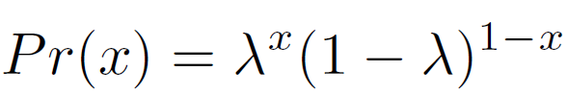
Bernoulli Distribution
or
Bernoulli distribution describes situation where only two possible outcomes x = 0 / x = 1 (e.g. failure/success)
Takes a single parameter
Notes:
We can write the probability in this compact form.
Suppose x is 0, then lambda to the power of 0 is 1, and we are left with 1 MINUS lambda. Suppose x is 1, then this second term is 1 and we are left with lambda.

Slide 86
Bernoulli Distribution
or
For short we write:
Bernoulli distribution describes situation where only two possible outcomes x = 0 / x = 1 (e.g. failure/success)
Takes a single parameter
Notes:
For short, we can write p of x as Ber of x GIVEN lambda, where Ber stands for Bernoulli

Slide 87
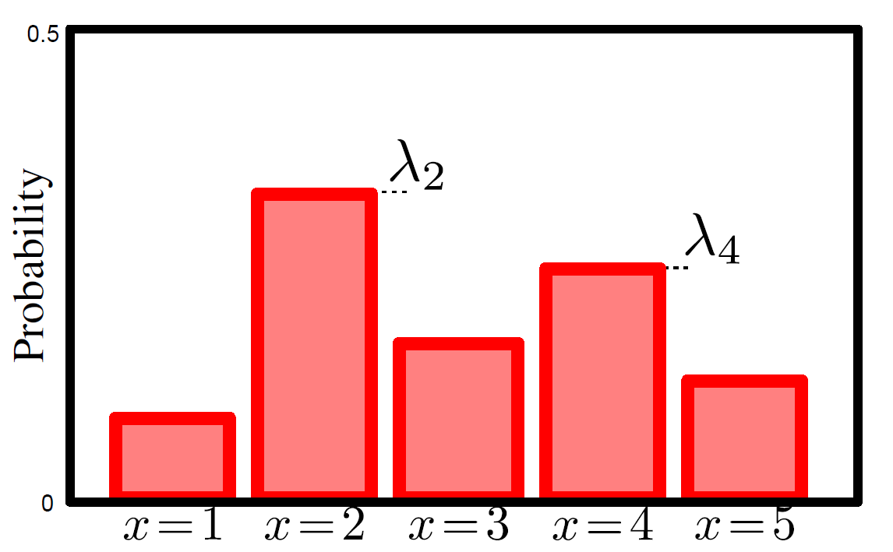
Categorical Distribution
Categorical distribution describes situation where K possible outcomes x = 1 , … , x = k , … , x = K.
Takes K parameters where
Notes:
A categorical distribution is like the bernoulli distribution, but with multiple discrete outcomes. So the outcome of one single dice roll is a categorical distribution.
The categorical distribution is controlled by lambda1, lambda2 to lambdaK. The lambdas are between 0 and 1, and they have to add up to 1.

Slide 88
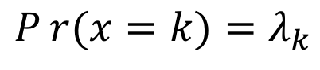
Categorical Distribution
$$Pr{(x=k)}=λ_{k}$$
Categorical distribution describes situation where K possible outcomes x = 1 , … , x = k , … , x = K.
Takes K parameters where
Notes:
Lambda k corresponds to the probability of observing the k-th category. So the probability of x = k is lambda k.

Slide 89
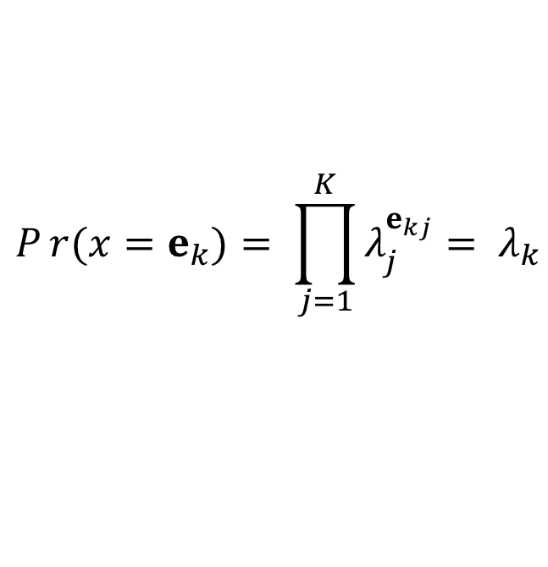
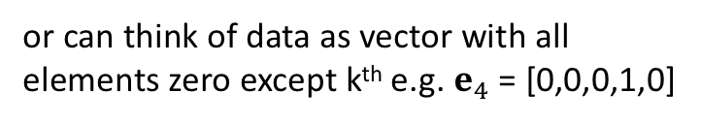
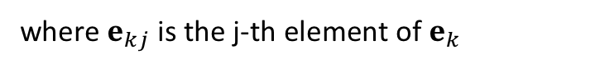
Categorical Distribution
$$Pr{(x=k)}=λ_{k}$$
or can think of data as vector with all elements zero except k^{th} e.g. $e_{4}$ = [0,0,0,1,0]
$$Pr{(x=e_{k})}= \prod_{j=1}^{K}{λ_{j}^{e_{kj}}= λ_{k}}$$
where $e_{kj}$ is the j-th element of $e_{k}$
Categorical distribution describes situation where K possible outcomes x = 1 , … , x = k , … , x = K.
Takes K parameters where
Notes:
We can write the probability in this form.
Suppose we think of x = k as a vector which is all zeros except that the k-element, which is equal to 1. We can denote this vector is ek. So e4 would be a vector which is all 0, except the 4th element which is 1.
Then the probability that x is k, is the same as the probability that x is ek, which is equal to the product of lambda j to the power of ekj, where ekj is the j-th element of the ek vector. So for example, if we are considering e4. then ekj is going to be 0 except when j is equal to 4, so we are left with lambda4.

Slide 90
Categorical Distribution
$$Pr{(x=k)}=λ_{k}$$
or can think of data as vector with all elements zero except k^{th} e.g. $e_{4}$ = [0,0,0,1,0]
$$Pr{(x=e_{k})}= \prod_{j=1}^{K}{λ_{j}^{e_{kj}}= λ_{k}}$$
where $e_{kj}$ is the j-th element of $e_{k}$
For short we write:
Categorical distribution describes situation where K possible outcomes x = 1 , … , x = k , … , x = K.
Takes K parameters where
Notes:
For short, we can write p of x is equal to cat of x GIVEN lambda. Cat stands for categorical.
Suppose we want to treat the lambdas as random variables.

Slide 91
Famous Continuous Random Variables
Gaussian: http://en.wikipedia.org/wiki/Normal_distribution
Uniform: http://en.wikipedia.org/wiki/Uniform_distribution_(continuous)
Exponential: http://en.wikipedia.org/wiki/Exponential_distribution
Beta: http://en.wikipedia.org/wiki/Beta_distribution
…
Notes:
Of course, there are also many famous continuous random variables. There’s Gaussian, Uniform, Exponential, Beta, etc. Again, you can easily find more information about these random variables on wikipedia. The most famous continuous random variable is of course the

Slide 92
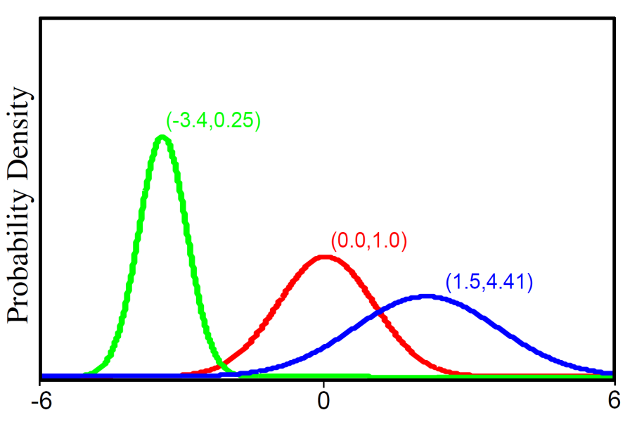
Gaussian/Normal Distribution
2 parameters mean μ and variance σ²>0
x
Adapted from S. Prince
Notes:
Gaussian or normal distribution. The probability density function (pdf) of the Gaussian distribution has two parameters, the mean mu and the standard deviation sigma. Sigma square is also known as the variance.
Let p(x) denote the probability distribution function of the Gaussian distribution. I will simply call this p of x or probability of x for short.
Anyway, p of x is equal to 1 divided by square root 2pi sigma square <POINT> times e to the negative <POINT> x minus mu square <POINT> divided by 2 sigma square.

Slide 93
Gaussian/Normal Distribution
≤ 0
2 parameters mean μ and variance σ²>0
x
Adapted from S. Prince
Notes:
Observe that this term is always less than or equal to 0. In particular, we get 0 when x is equal to mean mu. This means that p(x) is the largest when x is equal to the mean mu.
These three different curves show the Gaussian pdf for different values of mean and variance. As we increase the mean from -3.4 to 0 to 1.5 <POINT>, the peak of the curve is shifted to the right from x = -3.4 to x = 0 to x = 1.5.
And as we increase the variance from 0.25 to 1 to 4.41, we see that the curve goes from narrow <POINT> to wider <POINT> to widest <POINT>. So the larger the variance, the more likely it is to observe a value of x far away from the mean.

Slide 94
Joint Probability
If we observe two random variables x & y multiple times, then some combinations of outcomes more likely than others
This information captured by joint probability distribution
Written as p(x, y), which is read as “joint probability distribution of x and y”
Adapted from S. Prince
Notes:
Suppose we observe two random variables X and Y multiple times, then some combinations of X and Y are more likely than others.
This variation in frequency is captured by the joint probability distribution: p(X, Y), which is read as “joint probability distribution of x and y”

Slide 95
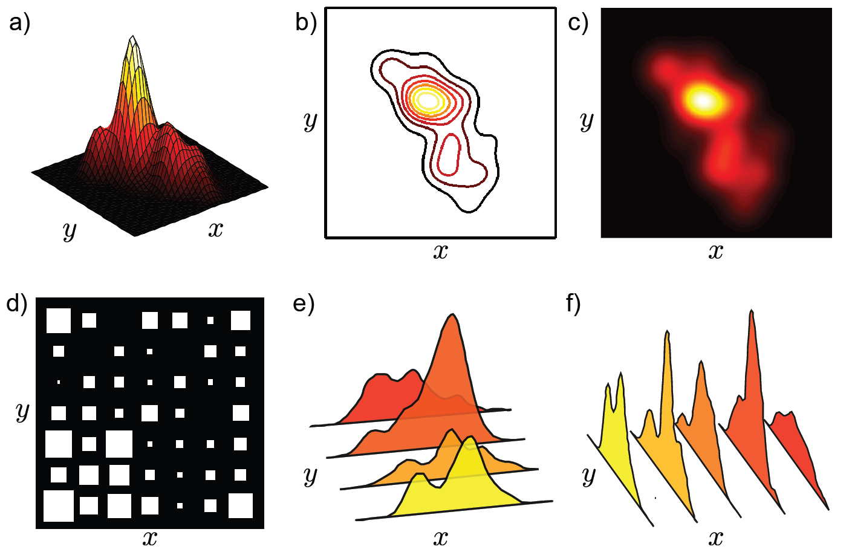
Joint Probability p(x, y)
unlikely
x & y discrete
most likely (x, y) pair
Adapted from S. Prince
Notes:
Here’s an example where X and Y are discrete random variables. The size of the white squares represent how likely it is to observe the particular pair of x and y values.
So the most likely pair of x, y corresponds to the bottom left hand corner. While this pair of x, y on top is impossible.
If we take the joint distribution p(x, y) and sum over all possible values of x and y, we get 1. In other words, if we add all the white squares we get 1.

Slide 96
Joint Probability p(x, y)
unlikely
most likely (x, y) pair
x & y discrete
x & y continuous
most likely (x, y) pair
unlikely
somewhat
likely
Adapted from S. Prince
Notes:
In this example, X and Y are continuous random variables. The brightness represent how likely it is to observe particular pairs of x, y values.
So in this example, the most likely pair of x, y values corresponds to this bright spot here. This pair of x,y values in this dark region here is highly unlikely.
Again, if we take the joint distribution p(x, y) and we integrate over the range of values of x and y, we get 1. In other words, if we integrate all these yellow, red and black intensity values, we get 1.

Slide 97
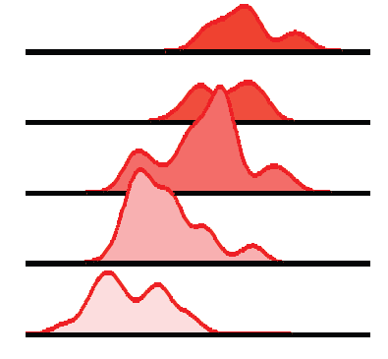
Joint Probability p(x, y)
unlikely
most likely (x, y) pair
x & y discrete
x & y continuous
x is continuous,
y is discrete
most likely (x, y) pair
unlikely
somewhat
likely
Adapted from S. Prince
Notes:
Finally, here’s an example where x is continuous – so x can take a continuum of values and y is discrete, so y only takes on a finite set of values.
Again, if we sum over the discrete values of y and integrate over the continuous values of x, we end up with 1.
<So far so good?>

Slide 98
Questions?
Notes:
Any questions before I continue?

Slide 99
Marginalization / Law of Total Probability
Notes:
Any questions before I continue?

Slide 100
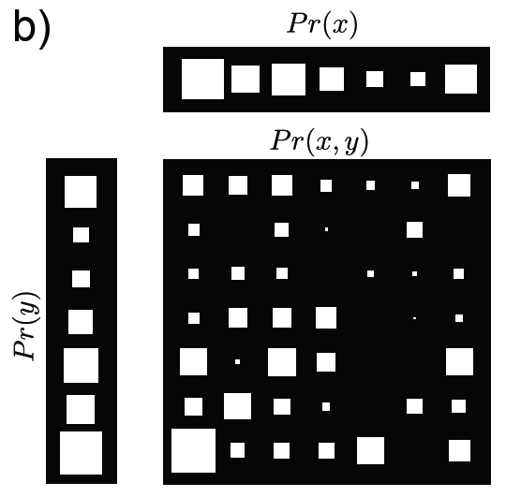
Marginalization / Law of Total Probability
We can recover probability distribution of any variable in a joint distribution by integrating (or summing) over the other variable(s). This is called marginalization.
Adapted from S. Prince
Notes:
Suppose x and y are discrete random variables. If we are given p(x, y), we can recover p(x) by summing over y. And we can recover p(y) by summing over x.
For example, let’s consider this joint distribution p(x, y) <POINT>. Again, the size of the white squares represent the magnitude of p(x, y). To get p(x), we can sum over all values of y. Visually, this means summing the vertical column of white squares corresponding to the different values of y. To get p(y), we can sum over x. Visually, this means summing the horizontal rows of white squares corresponding to the different values of x.
This processing of eliminating y or eliminating x is known as marginalization. The equations are known as Law of Total Probability
<PAUSE>

Slide 101
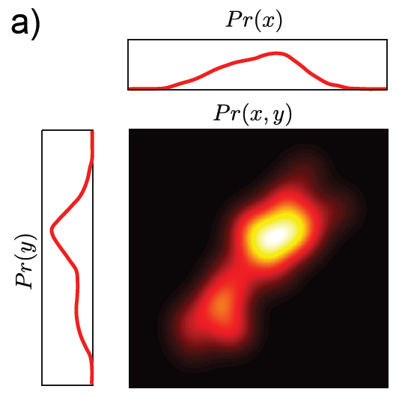
Marginalization / Law of Total Probability
We can recover probability distribution of any variable in a joint distribution by integrating (or summing) over the other variable(s). This is called marginalization.
Adapted from S. Prince
Notes:
When x and y are continuous random variables, we replace the summation with integrals. Do you see how similar the equations are with the previous slide <flip back and forth>?
For example, let’s consider this example. Again, the brightness represents p(x, y)
To get p(x), we integrate over y. Visually, this means integrating the vertical column of intensity values corresponding to the different continuous values of y.
To get p(y), we integrate over x. Visually, this means integrating the horizontal rows of values corresponding to the different continuous values of x.

Slide 102
Marginalization Example
p(x, y)
x
 |  | 0 | 2.5
 | -3 | 0 | 1/2
y | -1 | 1/8 | 1/4
 | 2 | 1/8 | 0
Notes:
So let’s consider the following joint distribution p(x, y). Observe that if we add the 6 numbers: 0, 1/2,1/8, 1/4, 1/8 and 0, we get a probability of 1.
X = 2.5 and y = -3 are the most likely pair of values with a joint probability of 1/2.
It is impossible to have X = 0 and y = -3. It is also impossible to have X = 2.5 and y = 2.

Slide 103
Marginalization Example
p(x, y)
x
 |  | 0 | 2.5 | p(y)?
 | -3 | 0 | 1/2
y | -1 | 1/8 | 1/4
 | 2 | 1/8 | 0
 | p(x)?
Notes:
What is the probability distribution of x? Remember that to compute p(x) we need to take the joint distribution p(x,y) and sum over all values of y.
So 0 plus 1/8 plus 1/8 gives 1/4.
And 1/2 plus 1/4 plus 0 gives 3/4

Slide 104
Marginalization Example
p(x, y)
x
 |  | 0 | 2.5 | p(y)?
 | -3 | 0 | 1/2
y | -1 | 1/8 | 1/4
 | 2 | 1/8 | 0
 | p(x)? | 1/4 | 3/4
Notes:
Which is shown here. Observe that 1/4 plus 3/4 is equal to 1.
Similarly, to compute p(y), we can take the joint distribution p(x,y) and sum over all possible values of x.
So 0 plus 1/2 gives 1/2.
1/8 plus 1/4 gives 3/8.
Finally 1/8 plus 0 plus 0 gives 1/8

Slide 105
Marginalization Example
p(x, y)
x
 |  | 0 | 2.5 | p(y)?
 | -3 | 0 | 1/2 | 1/2
y | -1 | 1/8 | 1/4 | 3/8
 | 2 | 1/8 | 0 | 1/8
 | p(x)? | 1/4 | 3/4
Notes:
Which is shown here.
Again, observe that 1/2 + 3/8 + 1/8 is equal to 1
<PAUSE>

Slide 106
Questions?
Notes:
Any questions before I continue?

Slide 107
Conditional Probability
Notes:
Any questions before I continue?

Slide 108
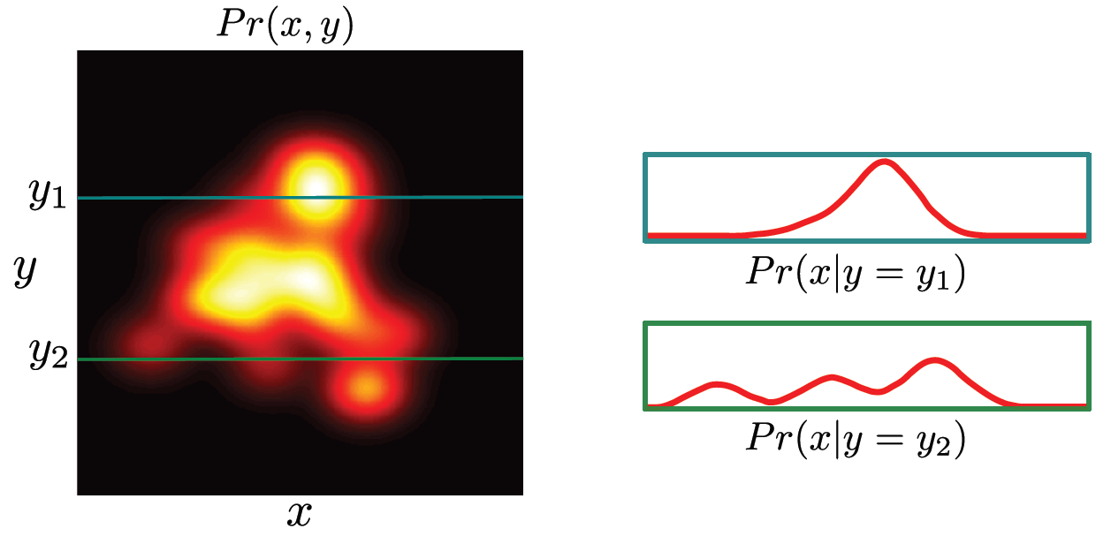
Conditional Probability
Suppose we observe y to be y₁, then p(x | y = y₁) is how likely x will take on various values given this observation
p(x | y = y₁) read as “conditional probability of X given Y is equal to y₁”
Adapted from S. Prince
Notes:
Suppose we have two random variables X and Y. Suppose Y is y1. Then p(x | y) is telling us how likely X will take on various values given that we have observed Y.
This is illustrated here. Suppose we observe Y to be y1. If we look at the intensity values along y1, so along this green line here, the intensity is brightest around this value of x. And so the conditional probability of X given Y = y1 is also the highest there.
Suppose we observe Y to be y2. If we look at the intensity values along y2, along this second green line here, we see the intensity is bright around here <POINT>, here <POINT> and here <POINT>, and so we get three peaks (here, here, and here) in the conditional probability of X given Y = y2.
Note that conditional probability is also a probability distribution, which means that if you take the conditional probability of x given y and integrate over all continuous values of x, we end up with 1. In other words, the area under each of these two red curves is equal to 1. We will use this fact to compute conditional probabilities from the joint distribution p(x, y).

Slide 109
Conditional Probability
Conditional probability can be computed from joint probability
slice of joint distribution
normalization factor to ensure conditional
probability is a proper distribution
Adapted from S. Prince
Notes:
So the conditional probability of X given that Y = y* is given by the joint distribution of X and Y = y* DIVIDED by the probability(Y = y*)
The numerator here corresponds to the green lines here, so it’s simply a slice of the joint probability distribution.
The denominator is necessary to ensure that the conditional probability is integrates to 1.

Slide 110
Conditional Probability
Conditional probability can be computed from joint probability
slice of joint distribution
normalization factor to ensure conditional
probability is a proper distribution
Adapted from S. Prince
Notes:
We can obtain the denominator by taking the joint distribution, and integrating over the continuous values of x.

Slide 111
Conditional Probability
More usually written in compact form
Can be re-arranged to give
Adapted from S. Prince
Notes:
We can write this in a more compact form: p of x given y is equal to p x y DIVIDED by p of y.

Slide 112
Conditional Probability
More usually written in compact form
Can be re-arranged to give
Can be re-arranged to give
Adapted from S. Prince
Notes:
We can bring p of y to the other side so that we get p(x, y) is equal to p(y) TIMES p(x|y).
By symmetry, P(x, y) is also equal to p(x) TIMES p(y | x).

Slide 113
Conditional Probability Example
x
 |  | 0 | 2.5 | p(y)
 | -3 | 0 | 1/2 | 1/2
y | -1 | 1/8 | 1/4 | 3/8
 | 2 | 1/8 | 0 | 1/8
 | p(x) | 1/4 | 3/4
???
Notes:
Recall our example from earlier. Where we start with the joint distribution p(x, y) <POINT>, and we computed p(x) <POINT> and p(y) <POINT>. Given what we have just learned, let’s compute p(x | y = -1).
When I encountered a math problem, I always try to transform what is unknown into of what is known. In this case, we do not know the conditional probability p(x | y = -1). But we do know the joint distribution p(x, y) <POINT>, and we know the two marginal distributions p(x) <POINT> and p(y) <POINT>.
The equation in the previous slide tells us how to relate the conditional distribution with the joint and marginal distributions, and so we have

Slide 114
Conditional Probability Example
x
 |  | 0 | 2.5 | p(y)
 | -3 | 0 | 1/2 | 1/2
y | -1 | 1/8 | 1/4 | 3/8
 | 2 | 1/8 | 0 | 1/8
 | p(x) | 1/4 | 3/4
Notes:
the following equality. p(x | y = -1) is equal to p(x, y = -1) divided by p(y = -1). The numerator is a slice of the joint distribution, and denominator ensures this conditional probability sums to 1.
At this point, observe that x can take on two values. x = 0 and x = 2.5, which means that this term really consists of two numbers. One number corresponding to when x = 0 and one number when x = 2.5

Slide 115
Conditional Probability Example
x
 |  | 0 | 2.5 | p(y)
 | -3 | 0 | 1/2 | 1/2
y | -1 | 1/8 | 1/4 | 3/8
 | 2 | 1/8 | 0 | 1/8
 | p(x) | 1/4 | 3/4
Notes:
So we have to solve these two terms. Let’s start with conditional probability p(x = 0 | y = -1). Plugging in the above equation, we get

Slide 116
Conditional Probability Example
x
 |  | 0 | 2.5 | p(y)
 | -3 | 0 | 1/2 | 1/2
y | -1 | 1/8 | 1/4 | 3/8
 | 2 | 1/8 | 0 | 1/8
 | p(x) | 1/4 | 3/4
Notes:
P(x = 0, y = -1) divided by p(y = -1).

Slide 117
Conditional Probability Example
x
 |  | 0 | 2.5 | p(y)
 | -3 | 0 | 1/2 | 1/2
y | -1 | 1/8 | 1/4 | 3/8
 | 2 | 1/8 | 0 | 1/8
 | p(x) | 1/4 | 3/4
Notes:
From the table, when x = 0 and y = -1, the probability is 1/8, so the numerator is 1/8.
And from the table, when p(y = -1) is 3/8 and so the denominator is 3/8.
Therefore we get one third.

Slide 118
Conditional Probability Example
x
 |  | 0 | 2.5 | p(y)
 | -3 | 0 | 1/2 | 1/2
y | -1 | 1/8 | 1/4 | 3/8
 | 2 | 1/8 | 0 | 1/8
 | p(x) | 1/4 | 3/4
Notes:
Let’s repeat this with the p(x = 2.5 | y = -1).
This is equal to p(x = 2.5, y = -1) divided by p(y = -1). From the table, when x = 2.5 and y = -1, the joint probability is 1/4, so the numerator is 1/4.
And from the table, when p(y = -1) is 3/8 and so the denominator is 3/8.
Therefore we get two thirds.
As a sanity check, observes that 1/3 + 2/3 is equal to 1.
<PAUSE>

Slide 119
Questions?
Notes:
Any questions before I continue?

Slide 120
Bayes’ Rule
Notes:
Any questions before I continue?

Slide 121
Deriving Bayes’ Rule (y continuous)
From before:
Equate RHS
Adapted from S. Prince
Notes:
An extremely important formula we will be using is Bayes’ rule.
Remember that p(x, y) is equal to p(y) TIMES p(x | y) AND p(x, y) is also equal to p(x) TIMES p(y | x)
If we equate the right hand sides, we get

Slide 122
Deriving Bayes’ Rule (y continuous)
From before:
Equate RHS
Combining:
Adapted from S. Prince
Notes:
p(y) TIMES p(x | y) is equal to p(x) TIMES p(y | x)
Let’s move p(x) from the right handside to the left handside

Slide 123
Deriving Bayes’ Rule (y continuous)
From before:
Equate RHS
Combining:
Re-arranging:
Adapted from S. Prince
Notes:
Therefore p(y | x) is equal to p(y) times p(x|y) divided by p(x).

Slide 124
Deriving Bayes’ Rule (y continuous)
From before:
Equate RHS
Combining:
Re-arranging:
Adapted from S. Prince
Notes:
This next equality is obtained by keeping the numerator the same, and using the fact that p(x) can be obtained by taking p(x, y) and integrating over the continuous values of y.

Slide 125
Deriving Bayes’ Rule (y continuous)
From before:
Equate RHS
Combining:
Re-arranging:
Adapted from S. Prince
Notes:
The final equality is obtained by keeping the numerator the same, and using the fact that p(x, y) is equal to p(y) TIMES p(x|y).
These three equations are known as Bayes rule. <PAUSE>
In this derivation, y is a continuous random variable. That’s why we use the integral sign.

Slide 126
Deriving Bayes’ Rule (y discrete)
From before:
Equate RHS
Combining:
Re-arranging:
Adapted from S. Prince
Notes:
If y is a discrete random variable, we simply replace the integral with a summation.
Do you see the similarity between this slide and the previous slide?

Slide 127
Bayes’ Rule
Prior – what we know about y BEFORE seeing x
Likelihood – propensity for observing a certain value of x given a certain value of y
Evidence – a constant to ensure that the left hand side is a valid distribution
Posterior – what we know about y AFTER seeing x
Adapted from S. Prince
Notes:
The different terms in Bayes’ rule actually have their own names.
Conditional probability p(y | x) is called the posterior, because this is the probability of y AFTER we observe x.
p(y) is known as the prior, which is the probability of y BEFORE observing x. p(x | y) is called the likelihood, which is the propensity of observing various values of x given a particular value of y. Finally, the denominator is called the evidence, which is simply the normalization term to ensure that the p(y | x) sums to 1.
Therefore the posterior is equal to the prior TIMES the likelihood DIVIDED by the evidence.

Slide 128
Bayes’ Rule Example
Notes:
Suppose a 40 year old woman is doing a mammogram, which is a test for breast cancer.
Let x be equal to 1 if the mammogram is positive and let y be equal to 1 if the woman has breast cancer.

Slide 129
Bayes’ Rule Example
Notes:
Suppose the test is positive, what is the probability of the woman having breast cancer?
In other words, we want to compute the posterior probability of y equals 1 given that x is equal to 1.
To compute this probability, we need to know a few things.

Slide 130
Bayes’ Rule Example
Notes:
Suppose the sensitivity of the test is 0.8, meaning that the probability of a positive test given that the patient has breast cancer is 0.8.
Suppose the false positive rate is 0.1, which is the probability of a positive test given that the patient does not have breast cancer is 0.1.
Furthermore suppose that the prior probability of a 40 year woman having breast cancer is 0.004. This means that 0.4% of 40 year old women have cancer.
We can then apply these numbers to Bayes’ rule

Slide 131
Bayes’ Rule Example
Notes:
So the posterior probability p(y = 1 | x = 1) is equal to the prior p(y = 1) TIMES the likelihood p(x = 1 | y = 1) DIVIDED by the evidence p(x = 1 | y = 1) TIMES p(y=1) + p(x = 1 | y = 0) TIMES p(y = 0).
We can plug in the numbers from above

Slide 132
Bayes’ Rule Example
Notes:
P(y = 1) is 0.004. P(x = 1 | y = 1) is 0.8. So the numerator is 0.004 TIMES 0.8
The first term in the denominator is also 0.004 TIMES 0.8
p(y = 0) is 1 – 0.004, which is 0.996. P(x = 1 | y = 0) is 0.1.
Therefore the posterior probability of the woman having breast cancer given the test is positive, is ONLY 0.031!

Slide 133
Bayes’ Rule Example
Notes:
This is why the US government no longer recommends routine mammogram for womens in their 40s because the prior probability of 40 year old woman having breast cancer is so low, and current mammograms are not sufficiently sensitive and the false positive rate is too high.
So even if the test comes back positive, there is still very low probability that the woman has breast cancer.

Slide 134
Questions?
Notes:
Any questions before I continue?

Slide 135
Independence
Notes:
Any questions before I continue?

Slide 136
Independence
If x & y are independent, then knowing x tells us nothing about y (and vice versa):
If x & y are independent, then joint distribution factorizes into product of marginal distributions:
Conversely, if joint distribution can be factorized into product of marginal distributions, then x & y are independent
Notes:
I want to point out a special situation, where knowing x tells us nothing about y and knowing y tells us nothing about x. This is known as independence.
If x and y are independent, then the conditional probability of x given y is the same as the probability of x.
Similarly, conditional probability of y given x is the same as the probability of y.
<PAUSE>

Slide 137
Independence
If x & y are independent, then knowing x tells us nothing about y (and vice versa):
If x & y are independent, then joint distribution factorizes into product of marginal distributions:
Conversely, if joint distribution can be factorized into product of marginal distributions, then x & y are independent
Notes:
Because p(x, y) is equal to p(x) times p(y | x). We can simplify the second term and drop its dependency on x.
Therefore when x and y are independent, their joint distribution p(x, y) is equal to p(x) TIMES p(y).
<PAUSE>

Slide 138
Independence
If x & y are independent, then knowing x tells us nothing about y (and vice versa):
If x & y are independent, then joint distribution factorizes into product of marginal distributions:
Conversely, if joint distribution can be factorized into product of marginal distributions, then x & y are independent
Notes:
Conversely, if p(x, y) is equal to p(x) TIMES p(y), then x and y are independent.
<PAUSE>

Slide 139
Questions?
Notes:
Any questions before I continue?

Slide 140
Expectation of One Random Variable
Notes:
Any questions before I continue?

Slide 141
Expectation
Expectation tells us the average (i.e., expected) value of some function f(x) taking into account the distribution of x
Definition:
Adapted from S. Prince
Notes:
The next topic for this lecture is expectation. Expectation tells us the average value of some function f[x] taking into account the distribution p(x)
In the case of discrete random variable, expected value of f(x) is equal to f(x) times p(x), summed over all possible values of x.
In the case of continuous random variable, expected value of f(x) is equal to the f(x) times p(x), integrated over all values of x.

Slide 142
Expectation: Mean and Variance
Notes:
When f(x) is equal to x, then this is called the expected value of x, which is also called the mean of x.
We can interpret the mean of x as follows. If we observe x infinite number of times and we average these observations, this average value will converge to mean of x.

Slide 143
Expectation: Mean and Variance
Notes:
Another special case is when f(x) is equal to x minus the mean of x square. This is called the variance of x.
The variance of x can be interpreted as follows. If we observe x infinite number of times and we average the square <PAUSE> of the difference between each observation and the mean of x, THEN the average value is the variance of x.
The variance of x measures how likely x is going to be far away from the mean.

Slide 144
Expectation Example: Mean
 |  | 0 | 2.5 | p(y)
 | -3 | 0 | 1/2 | 1/2
y | -1 | 1/8 | 1/4 | 3/8
 | 2 | 1/8 | 0 | 1/8
 | p(x) | 1/4 | 3/4
Notes:
Let’s consider our previous example and compute the mean of x.
We take the definition of expectation and set f(x) to be x and so we take x TIMES p(x) and sum over all values of x.

Slide 145
Expectation Example: Mean
 |  | 0 | 2.5 | p(y)
 | -3 | 0 | 1/2 | 1/2
y | -1 | 1/8 | 1/4 | 3/8
 | 2 | 1/8 | 0 | 1/8
 | p(x) | 1/4 | 3/4
x
Notes:
This is equal to 0 times 1/4 <POINT> plus 2.5 times 3/4.
And the final answer is 1.875.

Slide 146
Expectation Example: Mean
 |  | 0 | 2.5 | p(y)
 | -3 | 0 | 1/2 | 1/2
y | -1 | 1/8 | 1/4 | 3/8
 | 2 | 1/8 | 0 | 1/8
 | p(x) | 1/4 | 3/4
x
Notes:
Similarly, we can compute the mean of y.
So -3 times 1/2 PLUS -1 times 3/8 PLUS 2 times 1/8 and we get -1.625

Slide 147
Expectation Example: Variance
 |  | 0 | 2.5 | p(y)
 | -3 | 0 | 1/2 | 1/2
y | -1 | 1/8 | 1/4 | 3/8
 | 2 | 1/8 | 0 | 1/8
 | p(x) | 1/4 | 3/4
x
Notes:
Now let’s compute the variance of x. In this case, f(x) is equal to x – mu x square.
And so the formula is (x – mu x) square times p(x) and we sum over all values of x.

Slide 148
Expectation Example: Variance
 |  | 0 | 2.5 | p(y)
 | -3 | 0 | 1/2 | 1/2
y | -1 | 1/8 | 1/4 | 3/8
 | 2 | 1/8 | 0 | 1/8
 | p(x) | 1/4 | 3/4
x
Notes:
The first term corresponds to x = 0 minus the mean, which is 1.875.
And we square the whole thing and multiply by p(x = 0), which is 1/4.

Slide 149
Expectation Example: Variance
 |  | 0 | 2.5 | p(y)
 | -3 | 0 | 1/2 | 1/2
y | -1 | 1/8 | 1/4 | 3/8
 | 2 | 1/8 | 0 | 1/8
 | p(x) | 1/4 | 3/4
x
Notes:
The second term corresponds to x = 2.5 minus the mean, which is 1.875.
And we square the whole thing and multiply by p(x = 2.5), which is ¾.
And the whole thing evaluates to 1.171875.

Slide 150
Expectation of Two Random Variables
Notes:
<So far so good? Any questions?>

Slide 151
Expectation for X, Y
Notes:
We can generalize the definition of expectation to multiple random variables. Expectation of f(x, y) is equal to f(x,y) times p(x,y), which we then integrate over all values of x and y.

Slide 152
Expectation for X, Y
Notes:
When f(x,y) is equal to x minus the mean of x TIMES y minus the mean of y, then the expectation is called the covariance of x and y.
The covariance of x and y measures how much x and y change together.
The covariance of x and y is positive if whenever x is GREATER than its mean, then y is also GREATER than its mean ON AVERAGE. And the covariance of x and y is negative if whenever x is GREATER than its mean, then y is SMALLER than its mean ON AVERAGE.

Slide 153
Expectation Example: Covariance
 |  | 0 | 2.5 | p(y)
 | -3 | 0 | 1/2 | 1/2
y | -1 | 1/8 | 1/4 | 3/8
 | 2 | 1/8 | 0 | 1/8
 | p(x) | 1/4 | 3/4
x
Notes:
Let’s consider the previous example again. We have previous computed mean of x to be 1.875, mean of y to be -1.625.
To compute Cov(x, y), we start with the definition of expectation and set f(x,y) to be x minus mean of x TIMES y minus mean of y.
And we multiply with p(x, y) and sum over all possible pairs of x and y.
Since there are 6 pairs of x and y, there are going to be 6 terms.

Slide 154
Expectation Example: Covariance
 |  | 0 | 2.5 | p(y)
 | -3 | 0 | 1/2 | 1/2
y | -1 | 1/8 | 1/4 | 3/8
 | 2 | 1/8 | 0 | 1/8
 | p(x) | 1/4 | 3/4
x
Notes:
So the first term corresponds to x = 0 and y = -3.
Therefore, we get x = 0 minus the mean of x, which is 1.875. AND y = -3 minus the mean of y, which is negative 1.625.
p(x = 0, y = -3) is equal to 0, so actually this term does not contribute to the covariance.

Slide 155
Expectation Example: Covariance
 |  | 0 | 2.5 | p(y)
 | -3 | 0 | 1/2 | 1/2
y | -1 | 1/8 | 1/4 | 3/8
 | 2 | 1/8 | 0 | 1/8
 | p(x) | 1/4 | 3/4
x
Notes:
The second term corresponds to x = 2.5 and y = -3.
Therefore we get x = 2.5 minus the mean of x, which is 1.875. AND y equals to -3 minus the mean of y, which is negative 1.625.
P(x = 2.5, y = -3) is equal to 1/2

Slide 156
Expectation Example: Covariance
 |  | 0 | 2.5 | p(y)
 | -3 | 0 | 1/2 | 1/2
y | -1 | 1/8 | 1/4 | 3/8
 | 2 | 1/8 | 0 | 1/8
 | p(x) | 1/4 | 3/4
x
Notes:
The third term corresponds to x = 0 and y = -1.
Therefore we get x = 0 minus the mean of x, which is 1.875. AND y = -1 minus the mean of y, which is negative 1.625
P(x = 0, y = -1) is equal to 1/8.

Slide 157
Expectation Example: Covariance
 |  | 0 | 2.5 | p(y)
 | -3 | 0 | 1/2 | 1/2
y | -1 | 1/8 | 1/4 | 3/8
 | 2 | 1/8 | 0 | 1/8
 | p(x) | 1/4 | 3/4
x
Notes:
And so on.

Slide 158
Expectation Example: Covariance
 |  | 0 | 2.5 | p(y)
 | -3 | 0 | 1/2 | 1/2
y | -1 | 1/8 | 1/4 | 3/8
 | 2 | 1/8 | 0 | 1/8
 | p(x) | 1/4 | 3/4
x
Notes:
And so on.

Slide 159
Expectation Example: Covariance
 |  | 0 | 2.5 | p(y)
 | -3 | 0 | 1/2 | 1/2
y | -1 | 1/8 | 1/4 | 3/8
 | 2 | 1/8 | 0 | 1/8
 | p(x) | 1/4 | 3/4
x
Notes:
And so on. And so we end up with the covariance of x and y to be -1.3
The covariance is negative, which makes sense because when x is small (e.g.., 0), y tends to be big (-1 or 2), while when x is big (e.g., 2.5), y tends to be small (-3 or -1).

Slide 160
Rules of Expectation
Notes:
Here are some important properties of expectation. The proofs are at the end of these slides.
The expectation of a non-random constant is simply itself. So expectation of c is c.

Slide 161
Rules of Expectation
Notes:
The next rule is Linearity of expectation. Suppose a and b are non-random constants, then the expectation of a times f(x) + b times g(x) is equal to a times expectation of f(x) + b times expectation of g(x). This is called linearity of expectation.

Slide 162
Rules of Expectation
Notes:
The next property is that the Cov(x, y) is equal to the expectation of x TIMES y minus the E(x) times E(y).
One consequence of this property is that the variance of x, which is equivalent to the covariance of x with itself … is equal to the expectation of x^2 MINUS the square of the expectation of x.

Slide 163
Rules of Expectation
Notes:
Finally, if x and y are independent, then the expectation of f(x) TIMES g(y) is equal to the expectation of f(x) TIMES expectation of g(y).
One consequence of this is that if x and y are independent, then Cov(x, y) is 0. Because if x and y are independent, then expectation of x TIMES y will be equal to E(x) TIMES E(Y). Therefore these two terms cancel and Cov(x, y) is equal to 0.
However, note that 0 covariance does not imply independence.
<pause>

Slide 164
Conditional Expectation
Notes:
Now let’s talk about conditional expectation.

Slide 165
Conditional Expectation
Notes:
Remember that p(x|y) is the conditional probability of x given y. So p(x|y) is a probability distribution over the random variable x.

Slide 166
Conditional Expectation
Notes:
Therefore we can define conditional expectation of f(x, y) given y as follows: We multiply f(x,y) with p(x|y) and sum over all values of x.

Slide 167
Conditional Expectation
Notes:
Conditional expectation tells us the average value of f(x,y) <PAUSE> taking into account the conditional probability of x given y.
This is the equation when x is a discrete random variable.

Slide 168
Conditional Expectation
Notes:
This is the equation when x is a continuous random variable. If I flip back and forth, you see that the difference is that we replace the summation with an integral.
There are different notations for conditional expectation. I like this notation the best because it makes the probability distribution explicit.
So we can read this notation as follows. We are looking for the average or expected value of f(x, y) <POINT> by taking into account the conditional distribution p(x | y) <POINT>.

Slide 169
Conditional Expectation Example
x
 |  | 0 | 2.5 | p(y)
 | -3 | 0 | 1/2 | 1/2
y | -1 | 1/8 | 1/4 | 3/8
 | 2 | 1/8 | 0 | 1/8
 | p(x) | 1/4 | 3/4
Notes:
Let’s do an example. This is the same probability distribution as before.
We already computed p(x = 0 | y = -1), which is 1/3. We also computed p(x = 2.5 | y = -1), which is 2/3. Observe that 1/3 + 2/3 = 1 because p(x | y) is a probability distribution over x.
We also computed the expected value of x, which is 1.875.
What is the expected value of x given that y = -1?

Slide 170
Conditional Expectation Example
x
 |  | 0 | 2.5 | p(y)
 | -3 | 0 | 1/2 | 1/2
y | -1 | 1/8 | 1/4 | 3/8
 | 2 | 1/8 | 0 | 1/8
 | p(x) | 1/4 | 3/4
Notes:
Well, let’s plug into our formula, where f(x, y) is equal to x.
Therefore, we have x TIMES p(x | y), summed over all values of x.
X can take on two values, so this sum consists of two terms.

Slide 171
Conditional Expectation Example
x
 |  | 0 | 2.5 | p(y)
 | -3 | 0 | 1/2 | 1/2
y | -1 | 1/8 | 1/4 | 3/8
 | 2 | 1/8 | 0 | 1/8
 | p(x) | 1/4 | 3/4
Notes:
The first term is x = 0 TIMES p(x = 0 | y = -1).
The second term is x = 2.5 TIMES p(x = 2.5 | y = -1).

Slide 172
Conditional Expectation Example
x
 |  | 0 | 2.5 | p(y)
 | -3 | 0 | 1/2 | 1/2
y | -1 | 1/8 | 1/4 | 3/8
 | 2 | 1/8 | 0 | 1/8
 | p(x) | 1/4 | 3/4
Notes:
p(x = 0 | y = -1) =1/3 AND p(x = 2.5 | y = -1) = 2/3.
And so we get 1.667. Observe that 1.667, is slightly smaller than expectation of x, 1.875.
The reason is that before we observe y, x can be equal to 2.5 with pretty high probability of 3/4. But after we observe y = -1, then p(x = 2.5 | y = -1) has gone down from 3/4 to 2/3. While p(x = 0 | y = -1) has gone up from 1/4 to 1/3. Therefore after we observe y = -1, the conditional expectation of x went down.

Slide 173
Questions
Notes:
Questions before I continue?

Slide 174
N Random Variables
Notes:
Questions before I continue?

Slide 175
N random variables (aka random vector)
Have focused on 2 random variables x and y
Notes:
So far we have focused on two random variables.

Slide 176
N random variables (aka random vector)
Have focused on 2 random variables x and y
In real applications, usually more than 2 variables (e.g., photo has > 1M pixels)
Notes:
Of course, in real applications, we usually have more than 2 random variables.
For example, an iphone photo has more than 1M pixels, so we can think of a photo as consisting of a million random variables

Slide 177
N random variables (aka random vector)
Have focused on 2 random variables x and y
In real applications, usually more than 2 variables (e.g., photo has > 1M pixels)
If we observe x₁, x₂, …, x_{N} multiple times, some combinations of outcomes more likely than others
Notes:
So, suppose we have N random variables, x1, x2 to xN and we observe them multiple times, then some combinations are more likely than others.

Slide 178
N random variables (aka random vector)
Have focused on 2 random variables x and y
In real applications, usually more than 2 variables (e.g., photo has > 1M pixels)
If we observe x₁, x₂, …, x_{N} multiple times, some combinations of outcomes more likely than others
This information captured by joint probability distribution function
Notes:
This variation in outcome likelihood is captured by the joint probability distribution

Slide 179
N random variables (aka random vector)
Have focused on 2 random variables x and y
In real applications, usually more than 2 variables (e.g., photo has > 1M pixels)
If we observe x₁, x₂, …, x_{N} multiple times, some combinations of outcomes more likely than others
This information captured by joint probability distribution function
Written as p(x₁, x₂, …, x_{N}), read as probability distribution of x₁ to x_{N}
If x₁, x₂, …, x_{N} continuous, then p refers to joint probability distribution function (pdf). If discrete, then refers to joint probability mass function (pmf)
Notes:
Which we write as p(x1, …, xN).
Again, I will read this as probability distribution of X1 to XN.
If x₁, x₂, …, x_{N} continuous, then p refers to joint probability distribution function (pdf). If discrete, then refers to joint probability mass function (pmf)

Slide 180
N random variables (aka random vector)
Have focused on 2 random variables x and y
In real applications, usually more than 2 variables (e.g., photo has > 1M pixels)
If we observe x₁, x₂, …, x_{N} multiple times, some combinations of outcomes more likely than others
This information captured by joint probability distribution function
Written as p(x₁, x₂, …, x_{N}), read as probability distribution of x₁ to x_{N}
If x₁, x₂, …, x_{N} continuous, then p refers to joint probability distribution function (pdf). If discrete, then refers to joint probability mass function (pmf)
Many properties for two random variables generalize naturally to more variables
Notes:
The good news is that many things we learn about two random variables generalizes NATURALLY to N random variables.

Slide 181
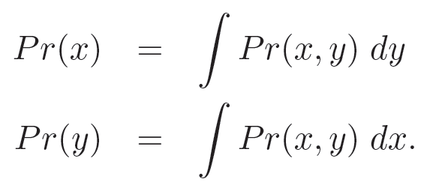
Marginalization / Law of Total Probability
We can recover probability distribution of any variable in a joint distribution by integrating (or summing) over the other variables
Notes:
Remember that if we have p(x, y).
To get p(x) we integrate over all values of y.
To get p(y) we integrate over all values of x?

Slide 182
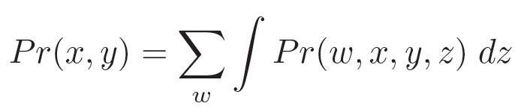
Marginalization / Law of Total Probability
We can recover probability distribution of any variable in a joint distribution by integrating (or summing) over the other variables
Works in higher dimensions as well – leaves joint distribution between whatever variables are left
Notes:
This works for higher dimensions as well.
If we have p(w, x, y, z). To get p(x, y) we sum over all values of w (assuming w is a discrete random variable) and we integrate over all values of z (assuming z is a continuous random variable).
<PAUSE>

Slide 183
Conditional Probability
Two variables
Three variables
N variables
Notes:
Conditional probability works the same way as well. For two variables, p(x,y) is equal p(x) TIMES p(y|x).

Slide 184
Conditional Probability
Two variables
Three variables
N variables
Notes:
For three variables, we can write p(a,b,c) to be p(a) TIMES p(b, c | a). The way I think about this is probability of observing a, b and c is the same as probability of observing a and then observing b and c conditioned on observing a.
And we can break down p(b, c | a) to become p(b | a) TIMES p(c | a, b). The way I think about this is that the probability of observing a, b and c is the same as probability of observing A and then observing B conditioned on observing A and finally the probability of observing C conditioned on observing A AND B

Slide 185
Conditional Probability
Two variables
Three variables
N variables
Notes:
We can repeat this for N random variables.
p(x1, …, xN) is equal to p(x1) TIMES p(x2 | x1) TIMES p(x3 | x1, x2) TIMES p(x4 | x1, x2, x3) and so on until p(xN | x1, x2, x3, … x(N-1))
And the way I think of this is that the probability of observing x1 to xN is equal to the probability of x1 TIMES the probability of x2 conditioned on already observing x1 TIMES the probability of x3 conditioned on already observing x1 and x2, and so on until the last term which is the probability of xN conditioned on already observing x1 to xN-1.

Slide 186
Independence
Notes:
The independence property is also the same as before.
Essentially, x1, x2 to xN are independent means that knowing any subset of x tells us nothing about the remaining x’s.

Slide 187
Independence
Notes:
More specifically, x1, x2 to xN are independent if and only if the joint distribution p(x1, x2, …, xN) can be factorized into p(x1) TIMES p(x2) TIMES p(x3) all the way to p(xN).

Slide 188
Independence
Notes:
Finally, we say that x1, x2 to xN are independently and identically distributed if they are independent and p(x1) = p(x2) = … = p(XN).

Slide 189
Conditional Independence
Notes:
Ok. When we have more than 2 random variables, there IS this new concept called conditional independence.
We say that x1 and x2 are conditionally independent given x3 if and only if p(x1, x2 | x3) is equal to p(x1 | x3) TIMES p(x2 | x3).
This means that if we already know x3, then x2 tells us nothing new about x1. Similarly, if we already know x3, knowing x1 tells us nothing new about x2.

Slide 190
Special Case I
If x₁ and x₂ are independent, it does NOT imply x₁ and x₂ are conditionally independent given x₃
Notes:
If x1 and x2 are independent, it does not mean that x1 and x2 will be conditionally independent given x3. This means that two random variables can be independent. But knowing a third random variable can cause them NOT to be independent.

Slide 191
Special Case I
If x₁ and x₂ are independent, it does NOT imply x₁ and x₂ are conditionally independent given x₃
Example: Let x = 1 if Thomas comes to class wet (0 otherwise). Let y = 1 if raining (0 otherwise). Let z = 1 if Thomas involved in water fight (0 otherwise)
Notes:
Suppose x = 1 if I come in to class wet and x = 0 if I come in to class dry.
Suppose there are only two reasons for me to be wet. Maybe because it is raining outside or maybe I was involved in a water fight.
Let y = 1 if it is raining and 0 if it is not raining.
AND Let z = 1 if I was involved in a water fight and 0 if I was not involved in a water fight.

Slide 192
Special Case I
If x₁ and x₂ are independent, it does NOT imply x₁ and x₂ are conditionally independent given x₃
Example: Let x = 1 if Thomas comes to class wet (0 otherwise). Let y = 1 if raining (0 otherwise). Let z = 1 if Thomas involved in water fight (0 otherwise)
Then y and z are independent (presumably)
But y and z are not conditionally independent given x
Because suppose I come to class wet. Then knowing it’s not raining would suggest I was in a water fight
Notes:
Then y and z are presumably independent. Whether I have a water fight or not is presumably independent of whether it is raining or NOT.
However y and z are not independent given x.
The reason is that suppose I come to class wet, so x = 1. Then knowing that it is NOT raining increases the possibility that I was involved in a water fight.
Therefore probability of z = 1 given y = 0 is higher if I come to class wet.

Slide 193
Special Case II
If x₁ and x₂ are conditionally independent given x₃, it does NOT imply x₁ and x₂ are independent
Example: Toss coin 99 times. Let q = probability of head. Let x_{n} = 1 if n-th coin toss = head and x_{n}= 0 if n-th coin toss = tail
x₁, x₂, … x₉₉ are independent conditioned on knowing q (e.g., q = 0.7)
If q is NOT known, then x₁, x₂, … x₉₉ are not independent
Imagine if all 99 coin tosses are equal to head, what would you guess about the 100th coin toss?
Probably confusing because in your previous statistics class, you might have seen equation like p(HHT) = q²(1-q)
This cannot be right since q does not appear on left hand side? How can it appear on right hand side?
Instead it should actually be p(HHT | q) = q²(1-q). The term ”| q” is implicit and is often dropped to reduce clutter
Notes:
If x1 and x2 are conditionally independent given x3, it does NOT mean that x1 and x2 are independent.

Slide 194
Special Case II
If x₁ and x₂ are conditionally independent given x₃, it does NOT imply x₁ and x₂ are independent
Example: Toss coin 99 times. Let q = probability of head. Let x_{n} = 1 if n-th coin toss = head and x_{n}= 0 if n-th coin toss = tail
x₁, x₂, … x₉₉ are independent conditioned on knowing q (e.g., q = 0.7)
If q is NOT known, then x₁, x₂, … x₉₉ are not independent
Imagine if all 99 coin tosses are equal to head, what would you guess about the 100th coin toss?
Probably confusing because in your previous statistics class, you might have seen equation like p(HHT) = q²(1-q)
This cannot be right since q does not appear on left hand side? How can it appear on right hand side?
Instead it should actually be p(HHT | q) = q²(1-q). The term ”| q” is implicit and is often dropped to reduce clutter
Notes:
For example, suppose we toss a coin 99 times independently.
The probability of getting head is q.
Let xn = 1 if the n-th coin toss is head and xn = 0 if the n-th coin toss gives tail.

Slide 195
Special Case II
If x₁ and x₂ are conditionally independent given x₃, it does NOT imply x₁ and x₂ are independent
Example: Toss coin 99 times. Let q = probability of head. Let x_{n} = 1 if n-th coin toss = head and x_{n}= 0 if n-th coin toss = tail
x₁, x₂, … x₉₉ are independent conditioned on knowing q (e.g., q = 0.7)
If q is NOT known, then x₁, x₂, … x₉₉ are not independent
Imagine if all 99 coin tosses are equal to head, what would you guess about the 100th coin toss?
Probably confusing because in your previous statistics class, you might have seen equation like p(HHT) = q²(1-q)
This cannot be right since q does not appear on left hand side? How can it appear on right hand side?
Instead it should actually be p(HHT | q) = q²(1-q). The term ”| q” is implicit and is often dropped to reduce clutter
Notes:
Then x1, x2, ..., x99 are independent conditioned on knowing that q is a particular value, e.g., 0.7.

Slide 196
Special Case II
If x₁ and x₂ are conditionally independent given x₃, it does NOT imply x₁ and x₂ are independent
Example: Toss coin 99 times. Let q = probability of head. Let x_{n} = 1 if n-th coin toss = head and x_{n}= 0 if n-th coin toss = tail
x₁, x₂, … x₉₉ are independent conditioned on knowing q (e.g., q = 0.7)
If q is NOT known, then x₁, x₂, … x₉₉ are not independent
Imagine if all 99 coin tosses are equal to head, what would you guess about the 100th coin toss?
Probably confusing because in your previous statistics class, you might have seen equation like p(HHT) = q²(1-q)
This cannot be right since q does not appear on left hand side? How can it appear on right hand side?
Instead it should actually be p(HHT | q) = q²(1-q). The term ”| q” is implicit and is often dropped to reduce clutter
Notes:
However, if q is not known, then x1, x2 and x3 are not independent.
The reason is that imagine we toss the coin 99 times, and we get heads all 99 times.
In that case, the next coin toss is probably going to be head.
Therefore if we do not know the value of q, then the coin tosses are NOT independent.

Slide 197
Special Case II
If x₁ and x₂ are conditionally independent given x₃, it does NOT imply x₁ and x₂ are independent
Example: Toss coin 99 times. Let q = probability of head. Let x_{n} = 1 if n-th coin toss = head and x_{n}= 0 if n-th coin toss = tail
x₁, x₂, … x₉₉ are independent conditioned on knowing q (e.g., q = 0.7)
If q is NOT known, then x₁, x₂, … x₉₉ are not independent
Imagine if all 99 coin tosses are equal to head, what would you guess about the 100th coin toss?
Probably confusing because in your previous statistics class, you might have seen equation like p(HHT) = q²(1-q)
This cannot be right since q does not appear on left hand side? How can it appear on right hand side?
Instead it should actually be p(HHT | q) = q²(1-q). The term ”| q” is implicit and is often dropped to reduce clutter
Notes:
One source of this confusion is that in your previous statistics class, you probably saw equation like this p(HHT) = q²(1-q)

Slide 198
Special Case II
If x₁ and x₂ are conditionally independent given x₃, it does NOT imply x₁ and x₂ are independent
Example: Toss coin 99 times. Let q = probability of head. Let x_{n} = 1 if n-th coin toss = head and x_{n}= 0 if n-th coin toss = tail
x₁, x₂, … x₉₉ are independent conditioned on knowing q (e.g., q = 0.7)
If q is NOT known, then x₁, x₂, … x₉₉ are not independent
Imagine if all 99 coin tosses are equal to head, what would you guess about the 100th coin toss?
Probably confusing because in your previous statistics class, you might have seen equation like p(HHT) = q²(1-q)
This cannot be right since q does not appear on left hand side? How can it appear on right hand side?
Instead it should actually be p(HHT | q) = q²(1-q). The term ”| q” is implicit and is often dropped to reduce clutter
Notes:
But this is actually wrong because q does not appear on the left hand side. How then can it appear on the right hand side?

Slide 199
Special Case II
If x₁ and x₂ are conditionally independent given x₃, it does NOT imply x₁ and x₂ are independent
Example: Toss coin 99 times. Let q = probability of head. Let x_{n} = 1 if n-th coin toss = head and x_{n}= 0 if n-th coin toss = tail
x₁, x₂, … x₉₉ are independent conditioned on knowing q (e.g., q = 0.7)
If q is NOT known, then x₁, x₂, … x₉₉ are not independent
Imagine if all 99 coin tosses are equal to head, what would you guess about the 100th coin toss?
Probably confusing because in your previous statistics class, you might have seen equation like p(HHT) = q²(1-q)
This cannot be right since q does not appear on left hand side? How can it appear on right hand side?
Instead it should actually be p(HHT | q) = q²(1-q). The term ”| q” is implicit and is often dropped to reduce clutter
Notes:
Instead the way to make the equation correct is p(HHT | q) = q²(1-q).
The term ”| q” is implicit and is often dropped to reduce clutter.

Slide 200
Summary
Discrete & continuous random variables
Probability distribution function / probability mass function
Joint distributions of N random variables
Marginalization / Law of Total Probability
Conditional probability
Bayes’ Rule
Independence, Conditional Independence
Expectation, conditional expectation

Slide 201
Optional Reading II
These notes are from Chapters 2 and 3 of SP (free download: www.computervisionmodels.com)
Review of probability & linear algebra by Dr. Tam Nguyen (download from LuminNUS)
Textbooks
Appendix A of D&H
Chapter 2 of KM (beware of typos)
Notes:
Here’s some optional reading.
SP stands for the book by Simon Prince. Computer Vision: Models, Learning and Inference.

Slide 202
Additional Material

Slide 203
Rules of Expectations
E[af(x) + bg(x)] = aE(f(x)) + bE(g(x))

Slide 204
Rules of Expectations
Cov(x,y) = E(xy)-E(x)E(y)
Expand the terms
Linearity of
Expectation
E(x) & E(y)
are constants

Slide 205
Rules of Expectations
If x & y are independent, then E[f(x)g(y)] = E[f(x)]E[g(y)]
x & y are
indepdent

